Slide 1

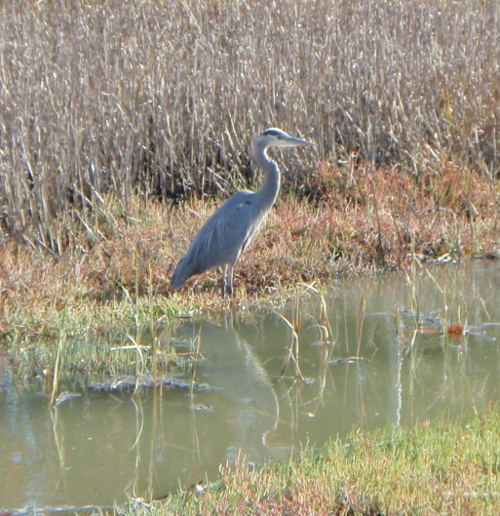
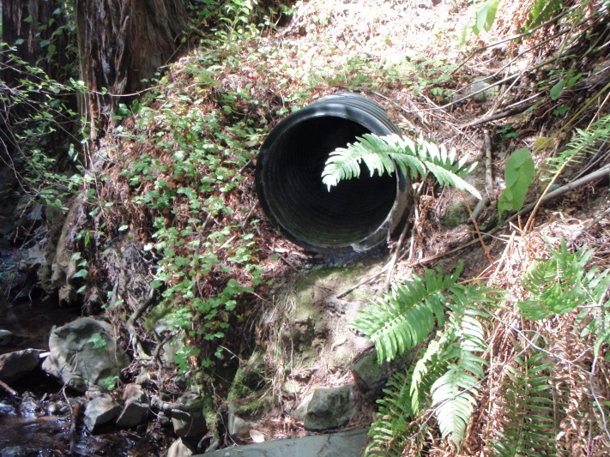
A Countywide Compliance Project for E.9.and E.11: Findings from the field, and bringing it all together in GIS
Howard Bunce, Liz Lotz, Terri Fashing, and Christina David
Marin County Stormwater Pollution Prevention Program (MCSTOPPP)

Slide 2
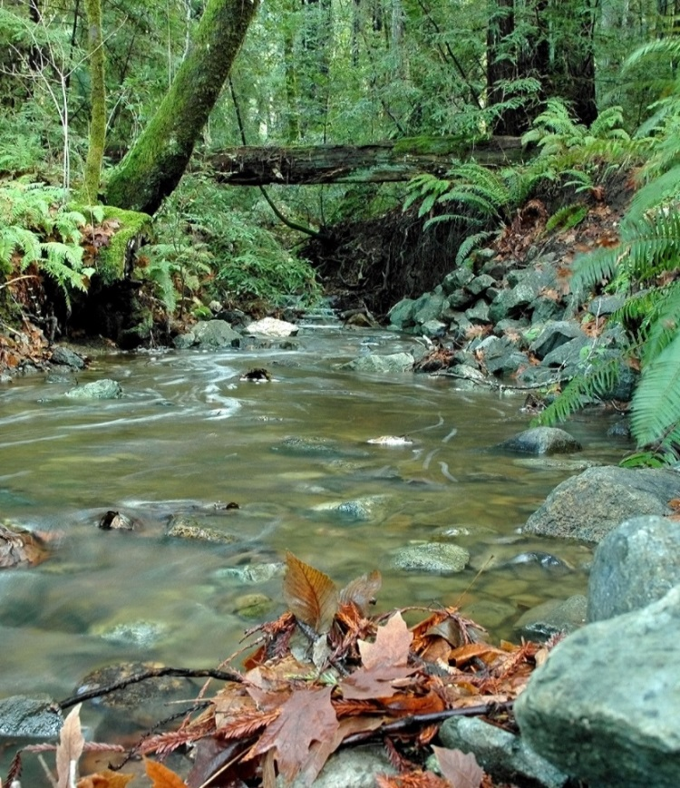
What is MCSTOPPP?
Joint effort of Marin’s 11 municipalities and the County
Countywide program assists with Phase II Stormwater Permit compliance
Protect water quality and beneficial uses in creeks, wetlands, and bays

Slide 3
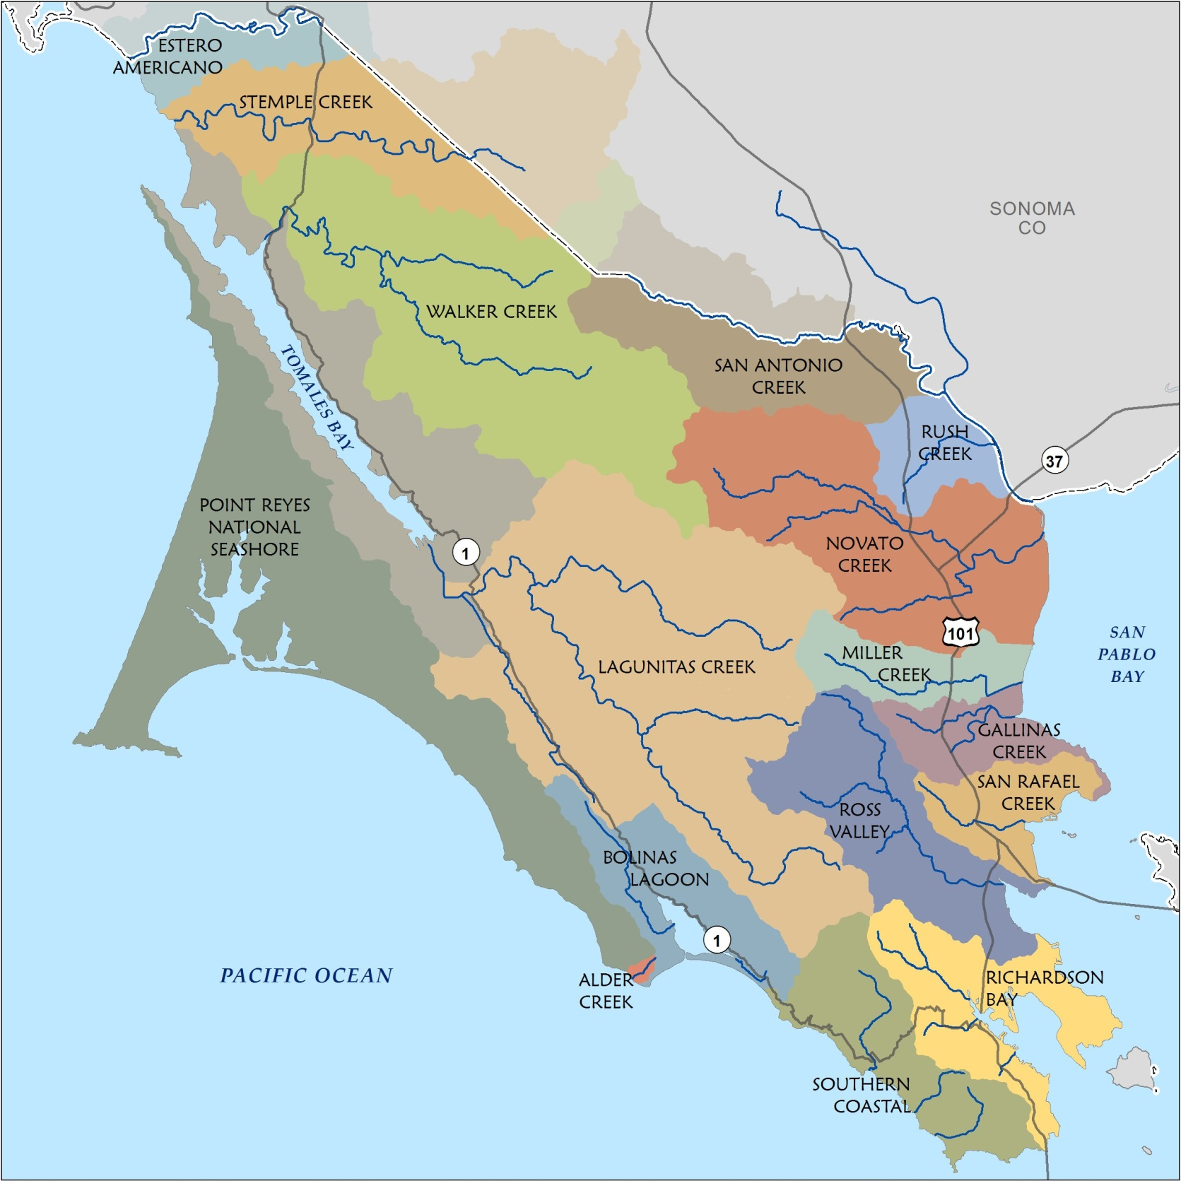

Slide 4
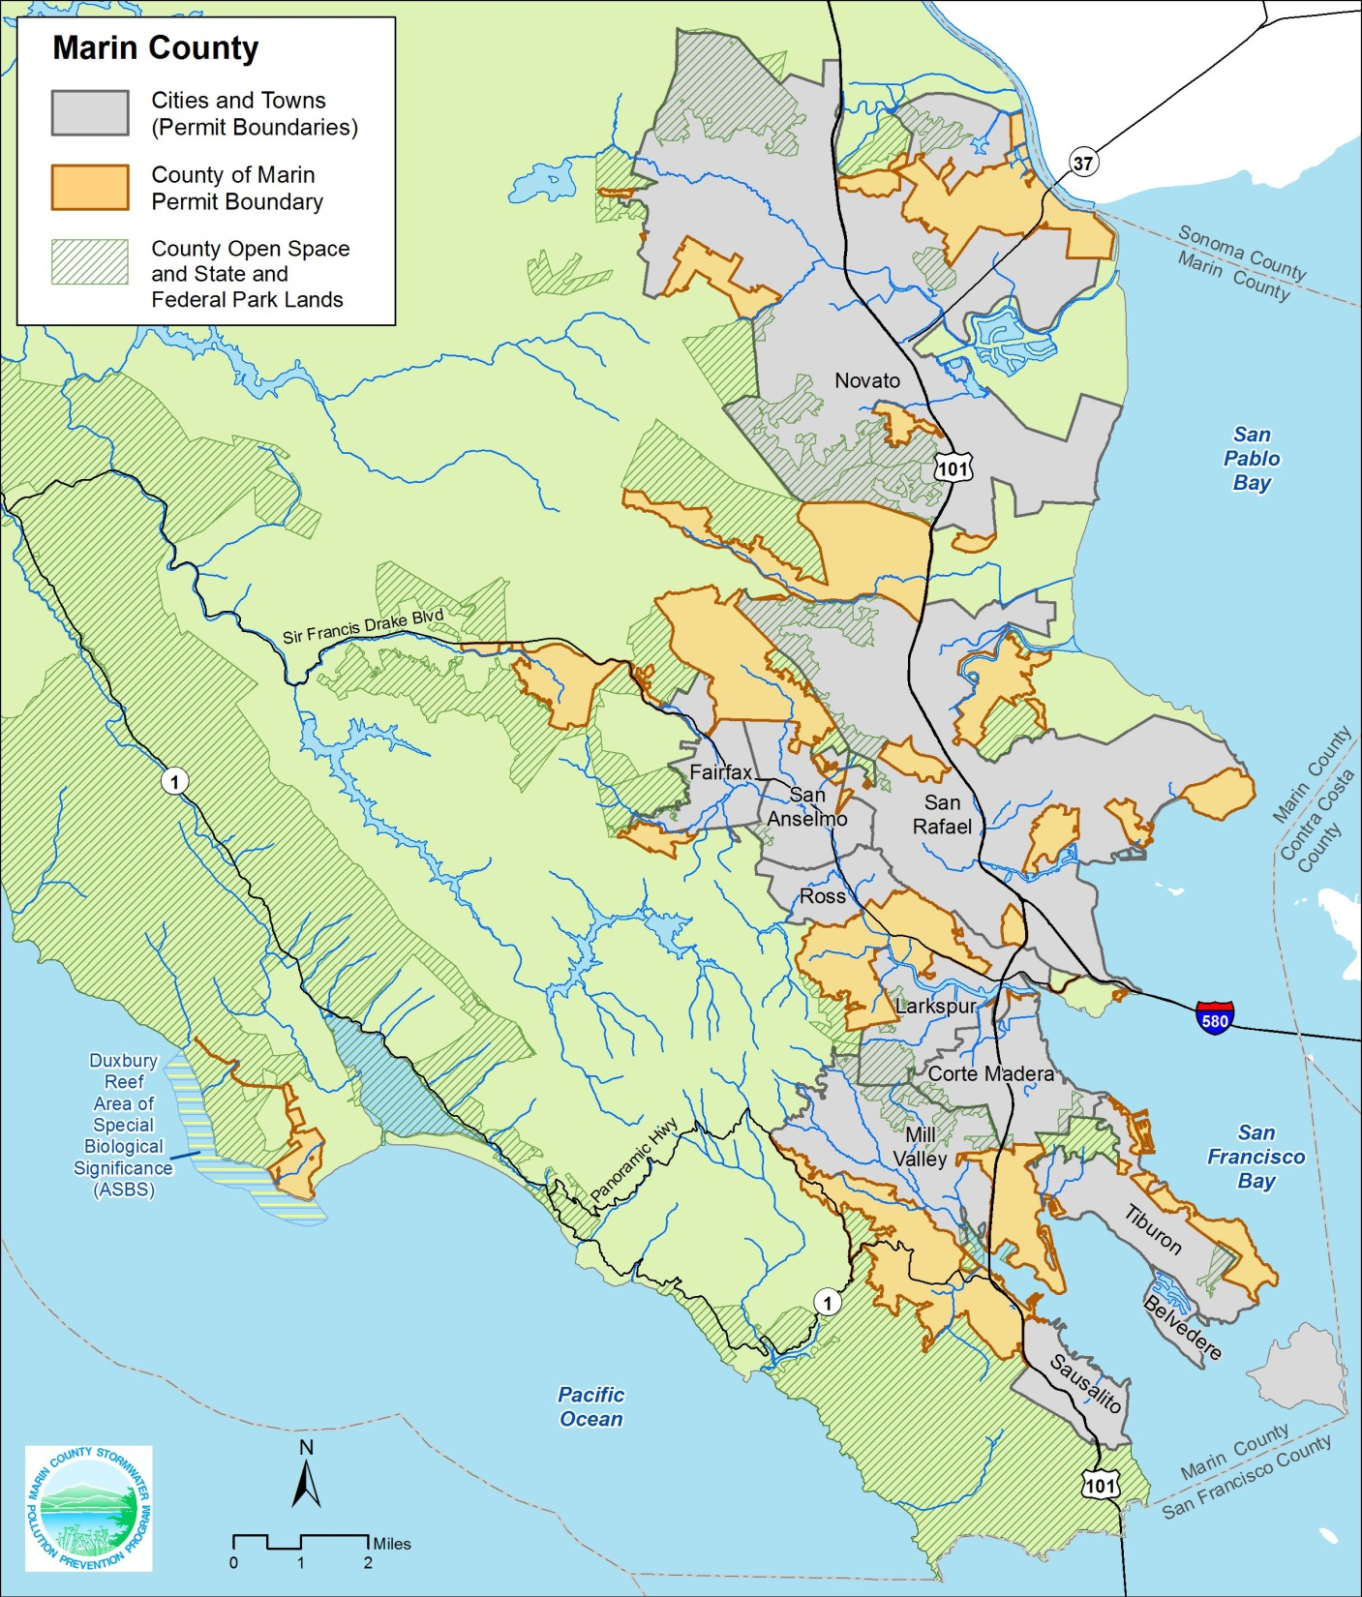

Slide 5
Permit Panic: How we got started
Initial reaction: We have to do what? By when?
Multiple mapping tasks in different Phase II Permit sections – we need a plan!
  Cost effective
  Consistent methodology
  Consistent monitoring and GIS data
  Oh, and it needed to start last year!

Slide 6
Mapping and Monitoring Tasks
Outfall mapping & dry weather flow monitoring
Inventory and map of select industrial & commercial businesses and their receiving storm drains
Inventory and map of municipally owned or operated facilities and their discharge points
Identify and map priority discharge areas
Use GIS to develop a comprehensive geodatabase and interactive map viewer
Notes:
land use, receiving water, and storm drain network data to develop priority areas, drainage areas, and storm drains receiving discharge

Slide 7
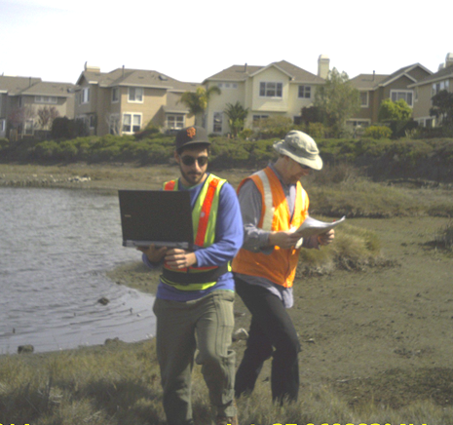
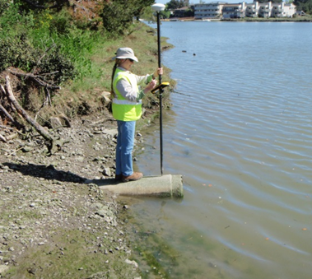
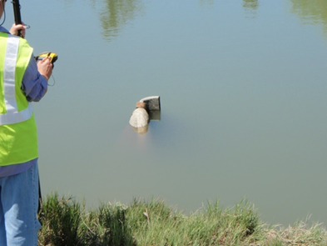
Dry Weather Outfall Monitoring:
Field Mapping and Assessment
Check for flow: determine source if present
  Sampling vs. tracking dry weather flow
Enter monitoring data on field tablet
Photo document condition
Collect GPS locations - where accessible!
        Import GPS data into GIS
        Digitize location of inaccessible outfalls
Notes:
Don’t sample if you can see the source!
Helpful when flows were inaccessible or too small to sample
Saves time, especially in smaller storm drain networks
More informative and useful data collection
Upshot – visual monitoring is still a good tool
Now what to do about the issues…
Tidally influenced, submerged, and inaccessible outfalls
Look for flow from the nearest upstream catch basin
Follow network further upstream if catch basin inundated
****Location based on existing data for inaccessible outfalls
If needed, take sample from nearest upstream accessible point

Slide 8
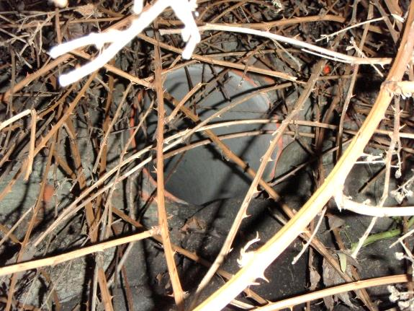
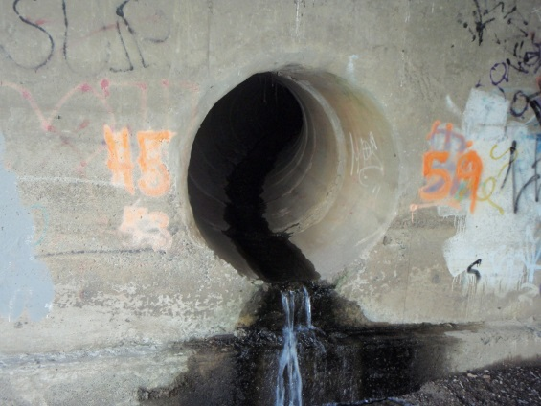
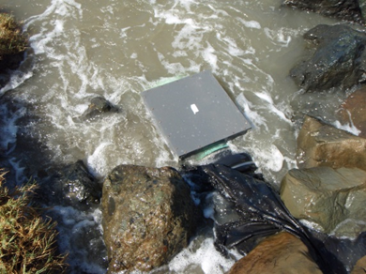
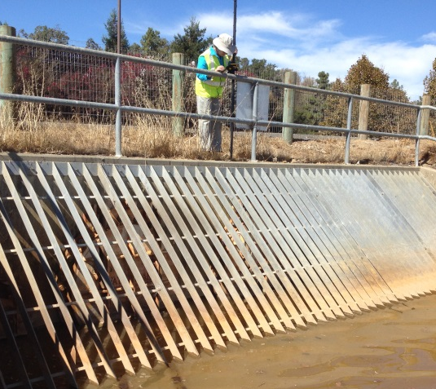
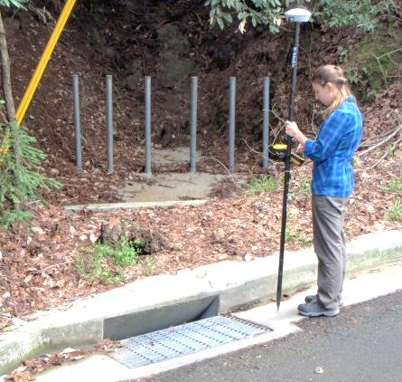
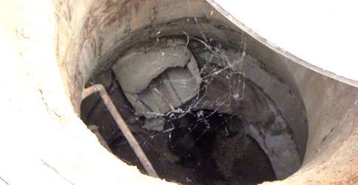
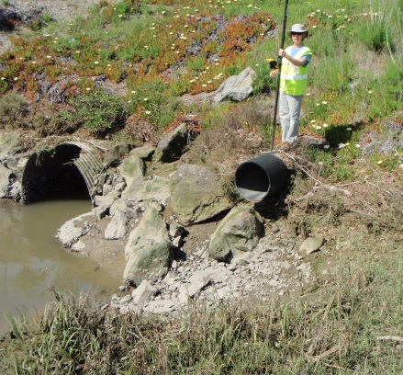
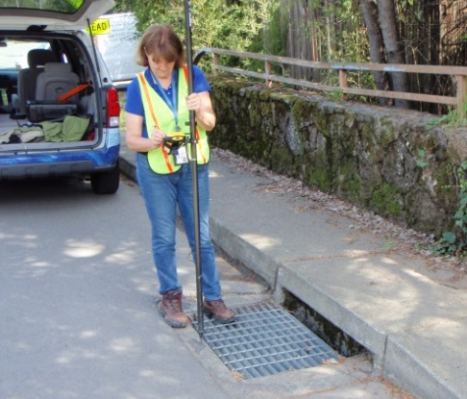
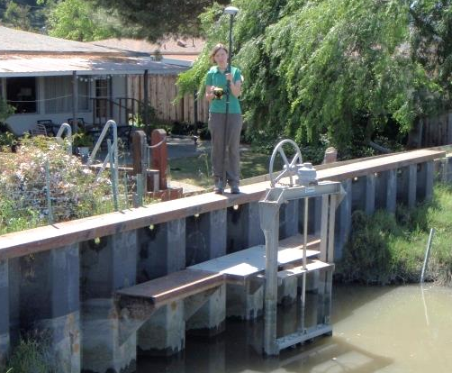
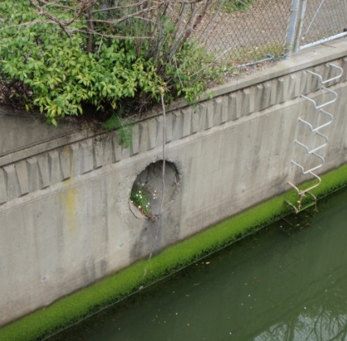
Outfalls
Notes:
We saw a wide variety of outfalls
Drop inlets and outfalls to culverted creeks
Outfalls from pump stations
Inaccessible outfalls

Slide 9
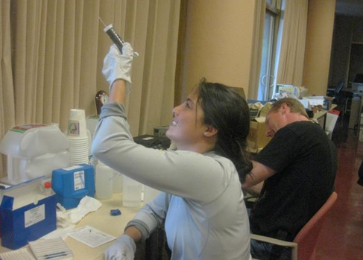
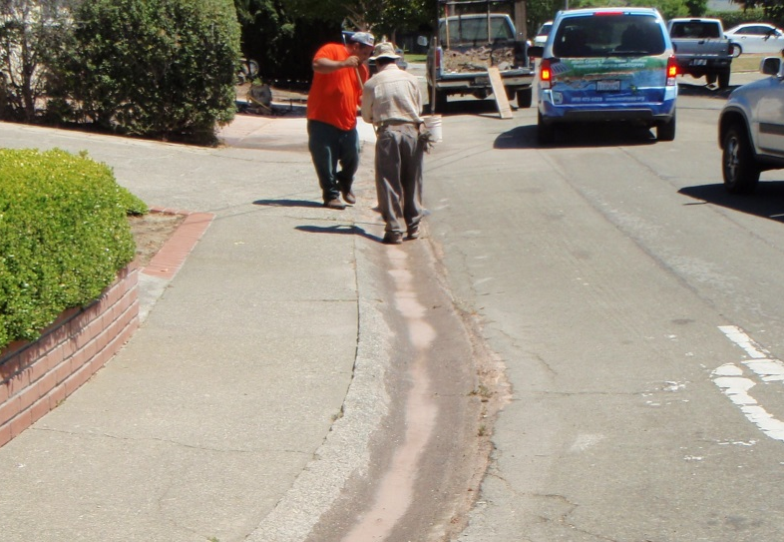
Results for Outfall Monitoring
2,340 outfalls assessed over a 21 month period
256 outfalls with dry weather flow (≈11%)
Zero exceedances of Action Level Concentrations
Most flows were identified as groundwater, and a lesser amount were minor over-irrigation (generally prior to fall 2014)
Outreach conducted for 11 discharges:
  (3) residential car washing
  (3) broken water lines
  (2) power washing house/driveway
  (2) considerable over-irrigation
  (1) construction site - new driveway
Notes:
Three residents washing cars in their driveway
Three broken/leaking water lines (leaks were already scheduled for repair with water districts at time of outreach)
Two properties power washing
Two residences with considerable over-irrigation
One construction site

Slide 10
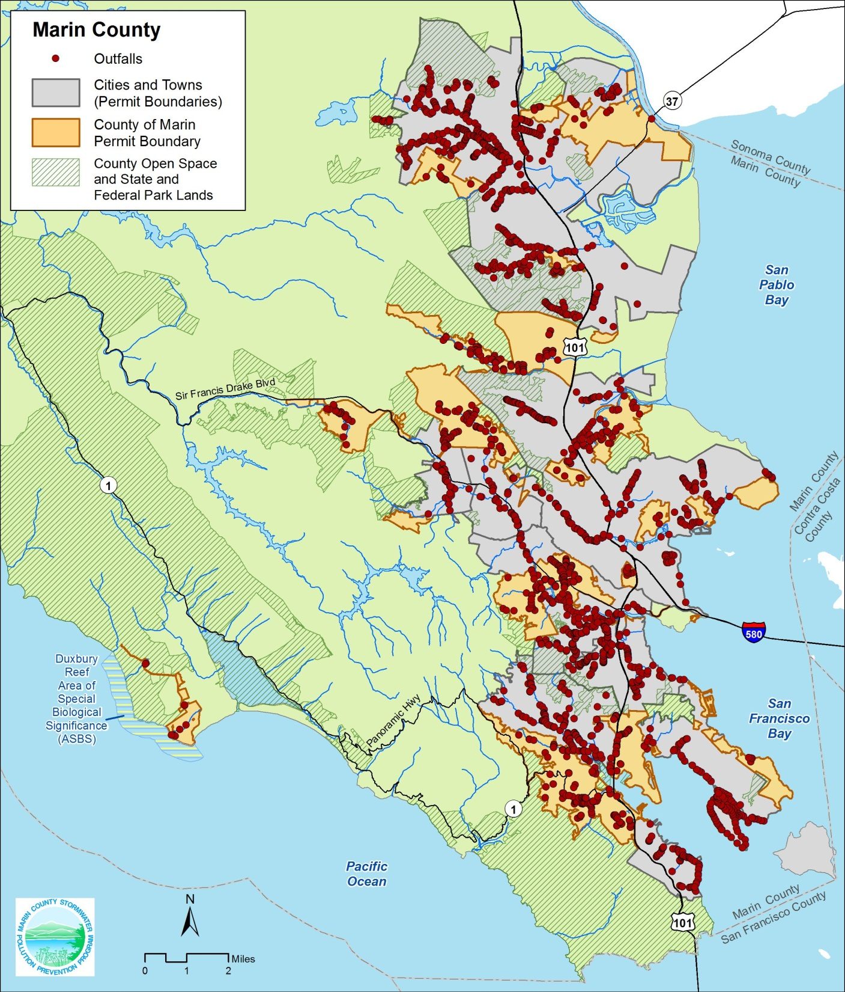

Slide 11
Take Aways from Dry Weather Flow Monitoring – Be Adaptive!
2,340 outfalls: zero exceedances of Action Level Concentrations – no levels even close.
Dry weather flow sampling not effective for detecting episodic discharges:
  21 months of monitoring = 11 violations requiring outreach or enforcement
  An average of 215 violations reported annually by the public
  Visual monitoring and tracking of flows provided more informative and useful data collection
Notes:
No exceedances of action levels from any outfalls!
In comparison, annually I typically receive between 80-100 violation calls a year that include illicit discharges, construction activity, and creek violations just for the unincorporated county for

Slide 12




Create Inventory and Map Locations for Select Businesses
Vehicle salvage yards
Metal/other recycled materials collection facilities
Waste transfer facilities
Vehicle mechanical repair, maintenance, or cleaning
Building trade central facilities or yards
Corp yards, landscape nurseries/greenhouses
Building material retailers and storage
Notes:
Business types specified in permit
Some municipalities do not have any of these business types
Most are vehicle maintenance and repair
We will continue to report on inspections completed by other agencies for other types of businesses such as restaurants, but separate from this requirement.

Slide 13

Desktop Mapping Methods
Obtained list of *CUPA-inspected businesses with street addresses, selected those fitting the permit guidelines, and added other businesses that need to be included
345 businesses mapped
Digitized locations of businesses and storm drains receiving discharge as points in GIS
Source data included existing GIS roads, parcels, storm drains, and hydrography flow lines; aerial photography; and Google Street View
*Certified Unified Program Agency
Notes:
Update on an annual basis
Business drainages were a primary factor in determining Priority Outfalls
Develop business inspection program for inventoried businesses not already inspected by other agencies such as CUPA, CMSA, and EHS

Slide 14
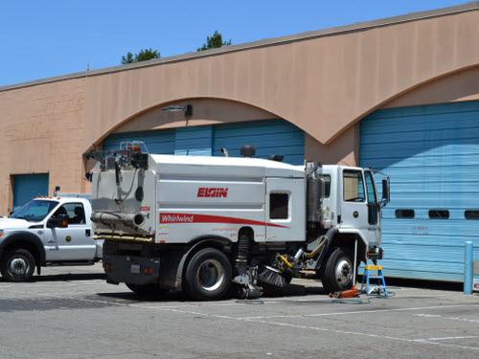

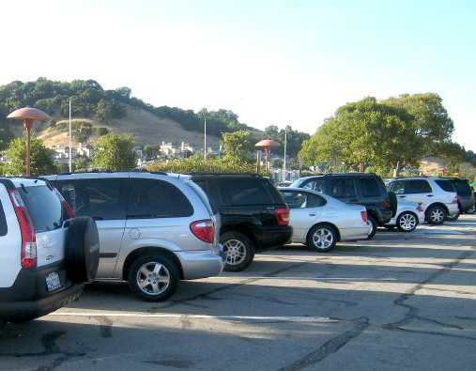

Create Map and Inventory of all
Municipally Owned/Operated Facilities
Obtain list of facilities from municipalities
Map each facility:
  Locate and select GIS parcel polygons
  Copy to Facilities geodatabase layer and add attributes
391 facilities mapped
Discharge points – inventory and attributes
Notes:
MCSTOPPP staff contacted member agencies to obtain list of facilities
Digitized some facilities within or outside of parcels
ALL FACILITIES! Corps yards, fire and police stations, pools, parks, libraries, municipal buildings… too many facility types to list… even parking lots!

Slide 15
Identify and Map
Priority Discharge Areas
Industrial, Commercial, and Mixed Land Use Areas:
  From GIS parcel data and use codes
  Buffer parcels to include road right-of-ways
  Adapted from previous mapping of priority land use areas for Trash Amendments
Additional areas based on local knowledge
Update Priority Areas annually
Notes:
Questionnaires based on other E.9.a criteria

Slide 16
How Will Maps be Used?
The Power of Location with Attributes!
Comprehensive GIS maps are providing invaluable information at the click of the mouse!
  Detailed information for all select businesses and municipal facilities
  Locate storm drains receiving discharges
  Identify municipal facility “hot spots”
  Priority Areas guide monitoring for illicit discharges
  Use all of the above to designate Priority Monitoring Outfalls
  Database to conduct targeted outreach to select business types

Slide 17
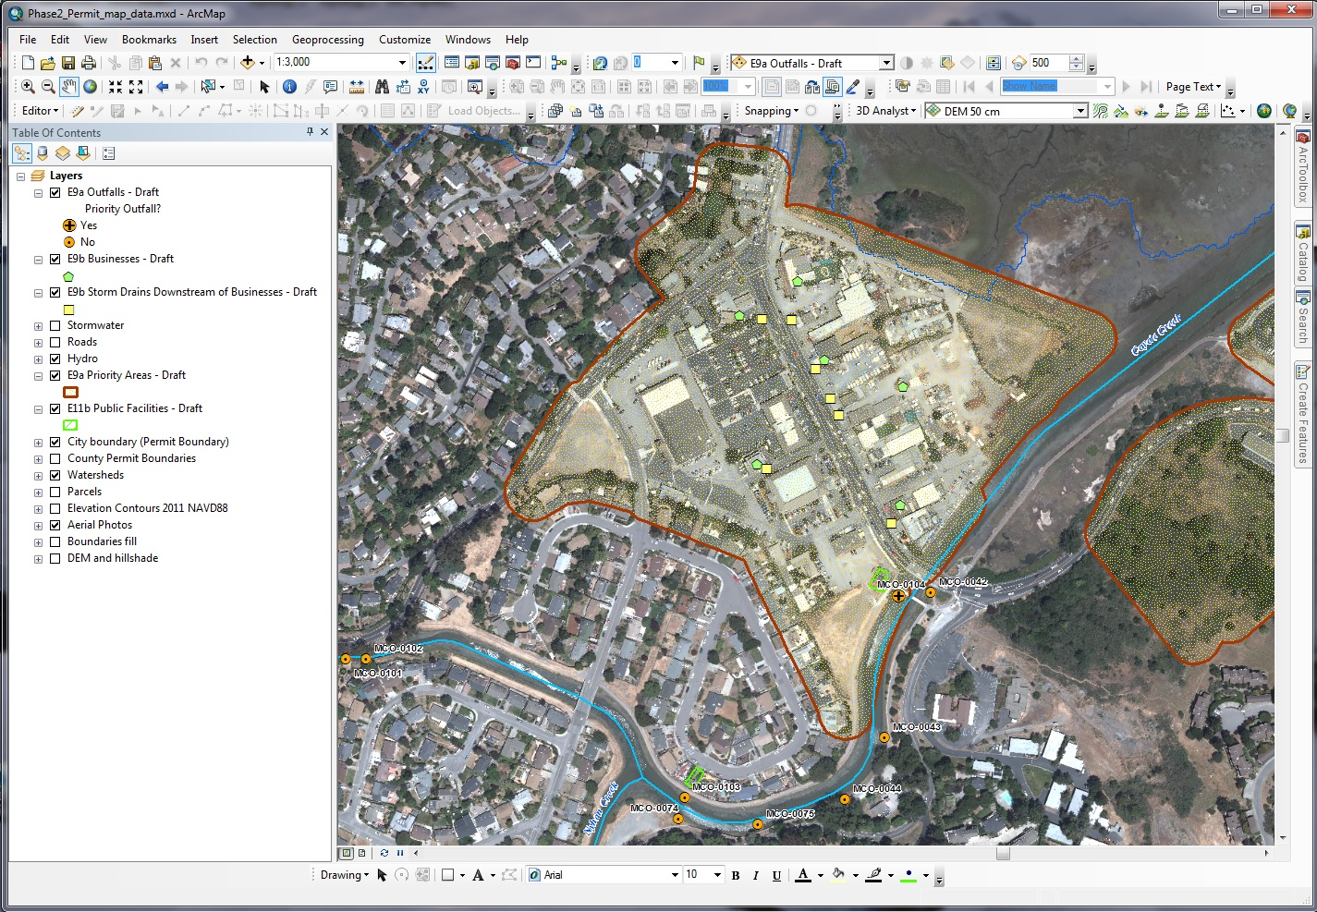

Slide 18

Deliver Map Data:
Marin Map
A consortium of public agencies (local governments, special districts) in Marin
GIS database and web-based computer applications that support agency programs
View data and make maps without specialized GIS software and expertise

Slide 19
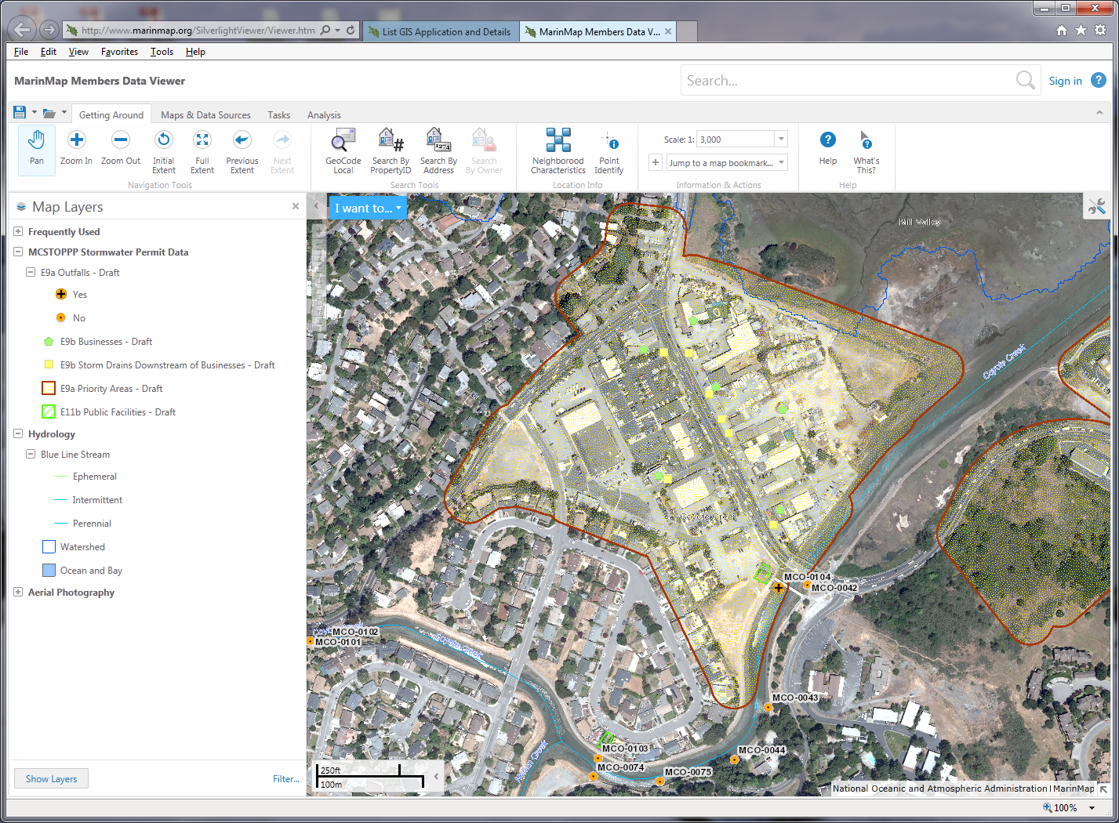

Slide 20
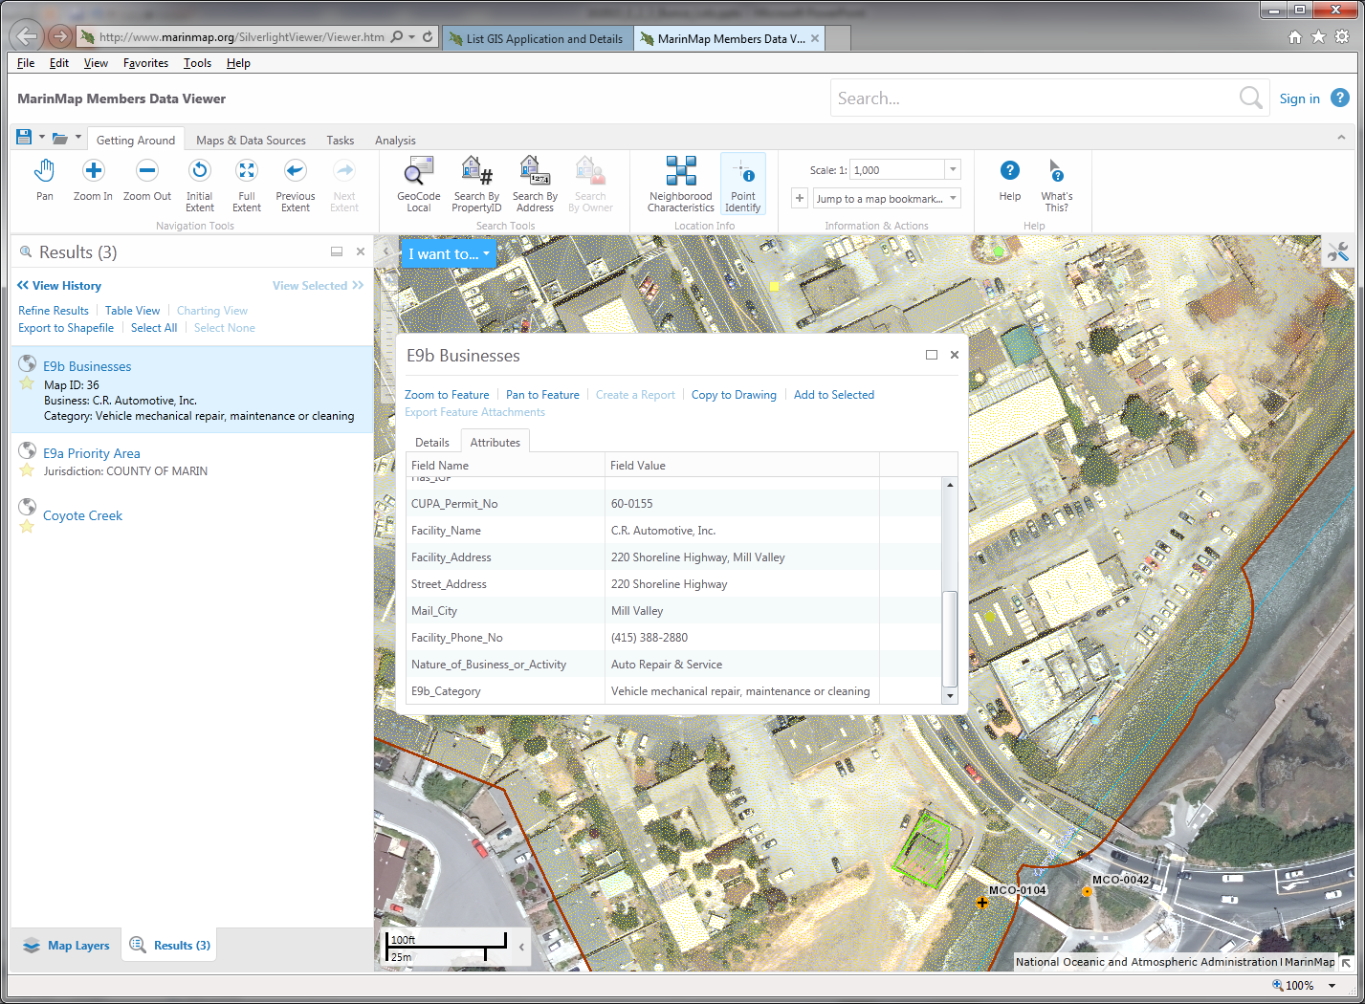

Slide 21
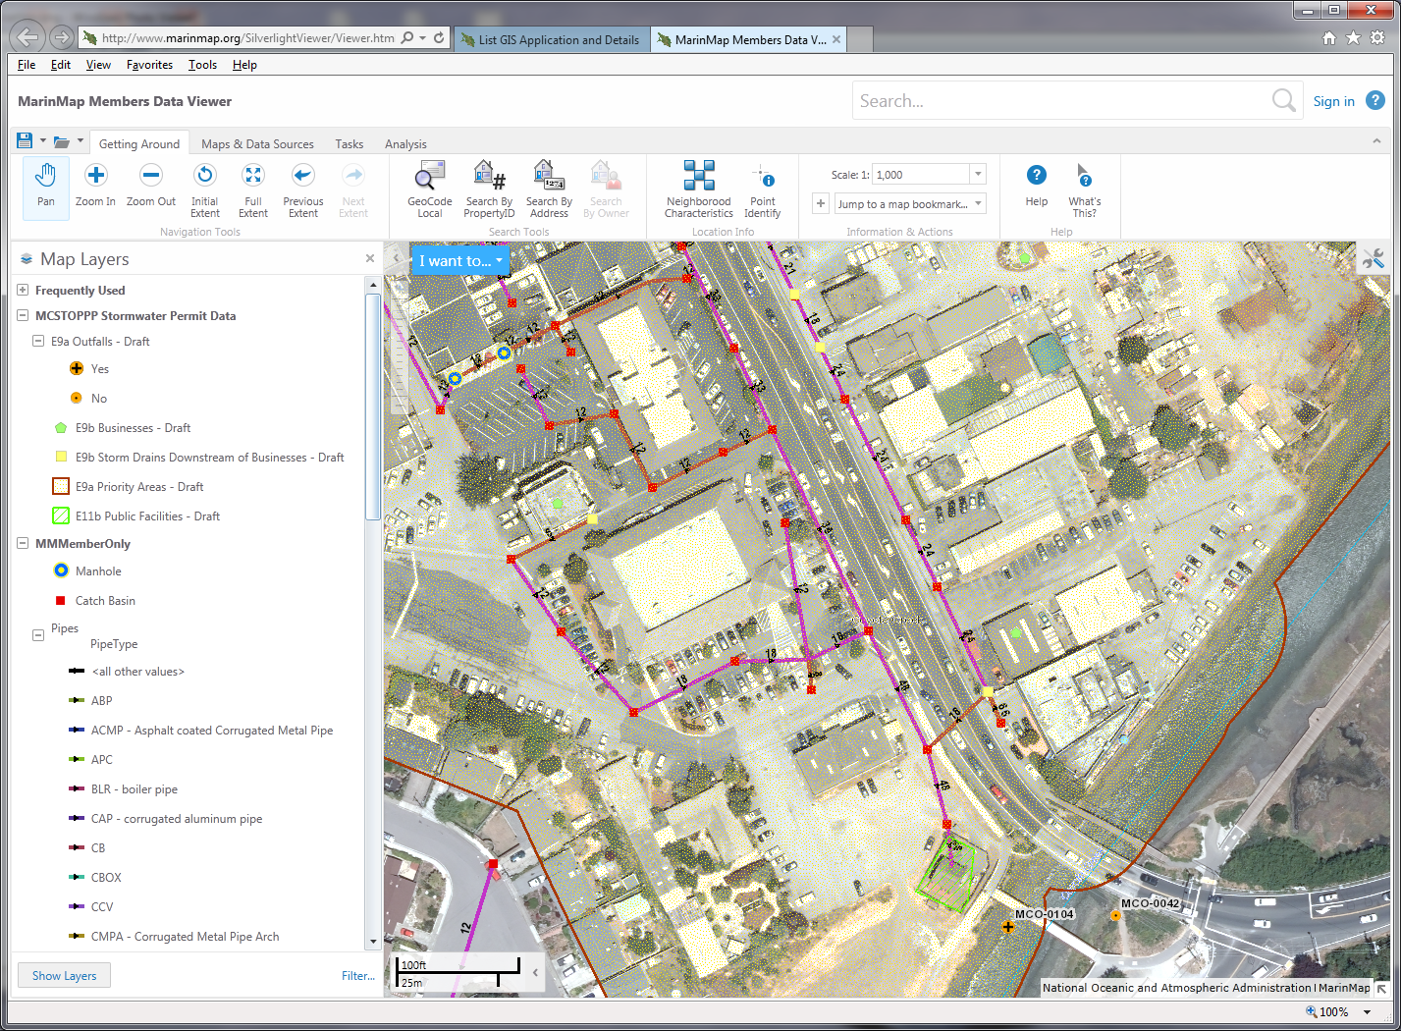

Slide 22
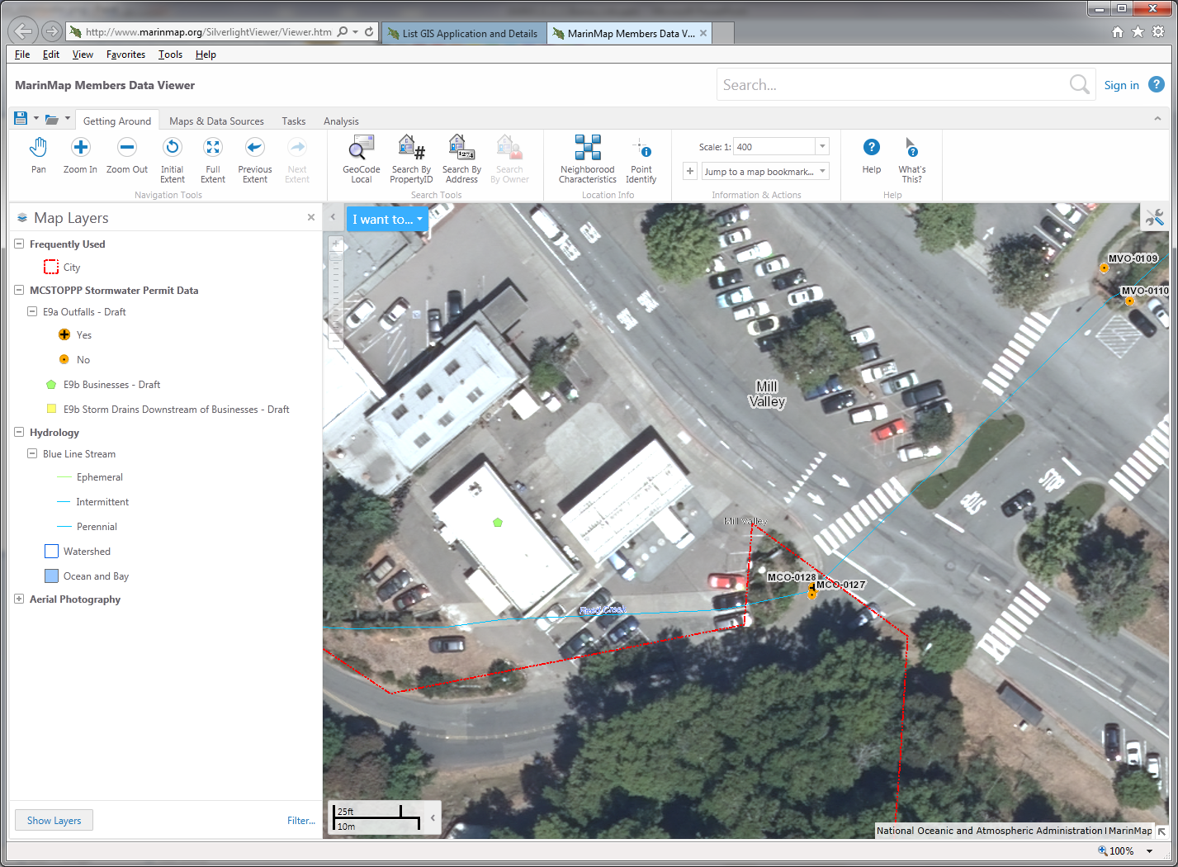

Slide 23
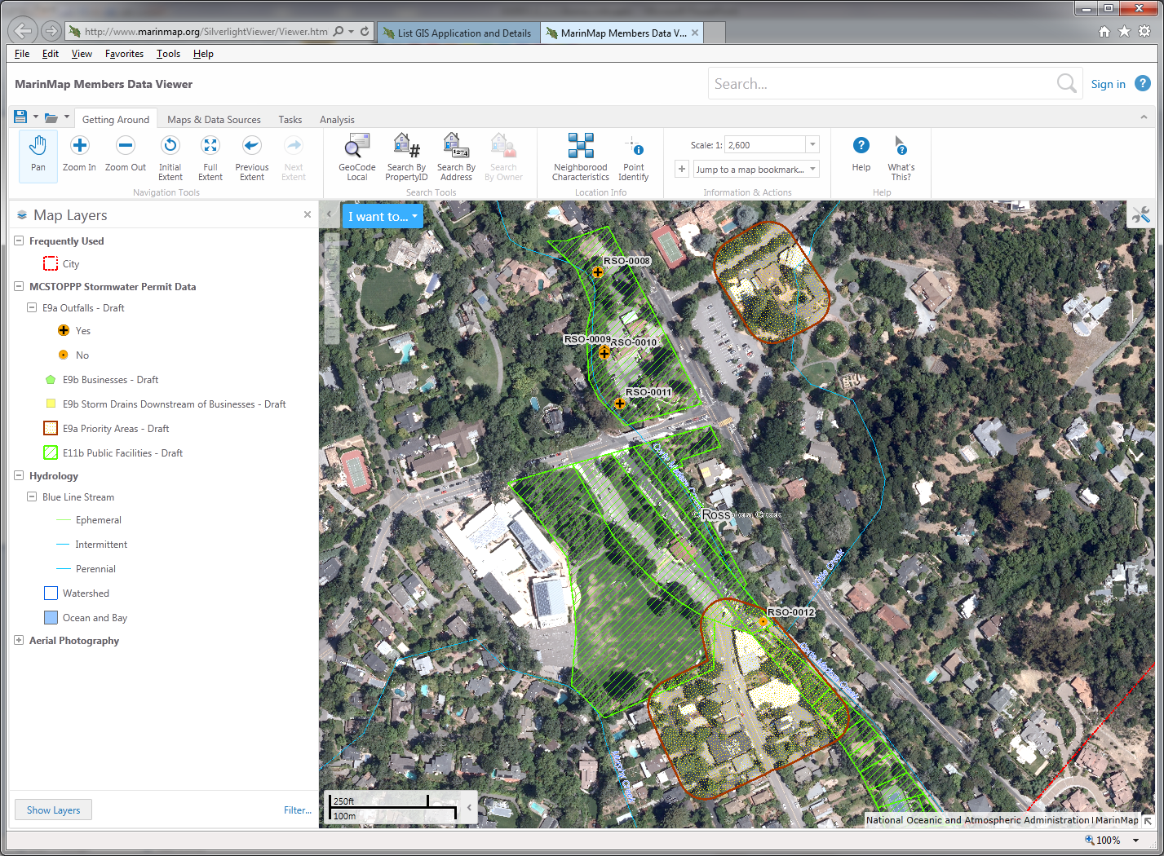

Slide 24
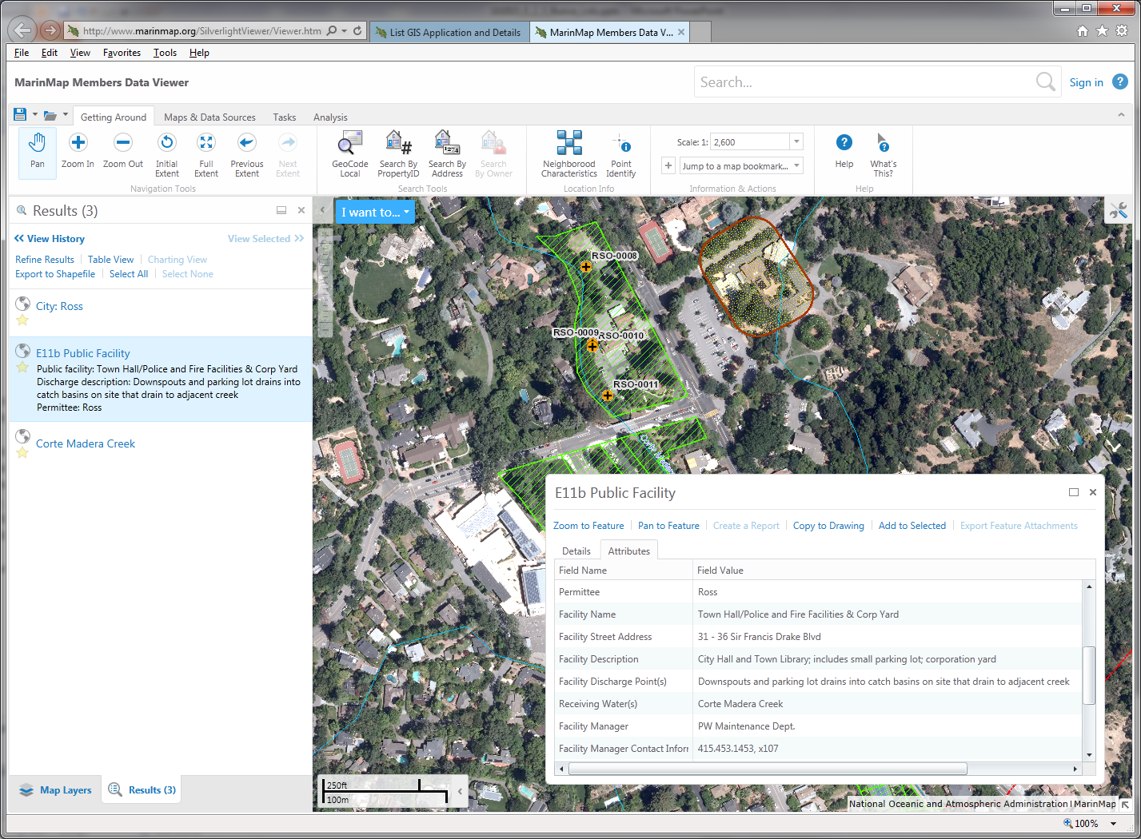

Slide 25
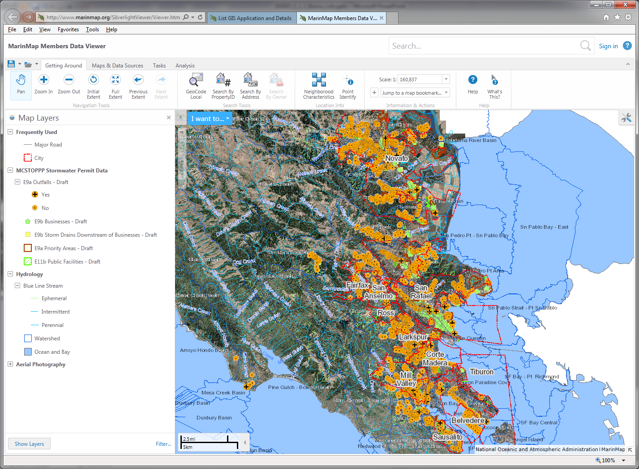

Slide 26
Monitoring Moving Forward
Program to proactively identify illicit discharges in Priority Areas includes:
  Dry weather flow monitoring of Priority Monitoring Outfalls
  Concurrent visual survey monitoring of Priority Areas
  Industrial/commercial inspections of inventoried facilities
  Inspector and municipal staff illicit discharge identification training – if you see something call us!
  Anonymous community illicit discharge reporting programs – continue promoting public involvement!

Slide 27
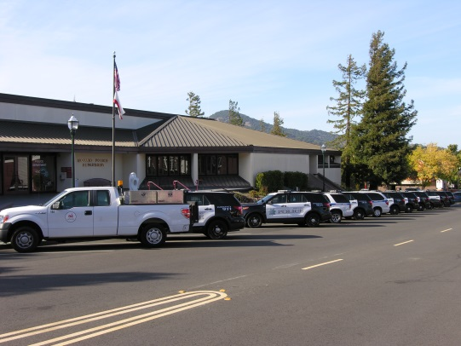

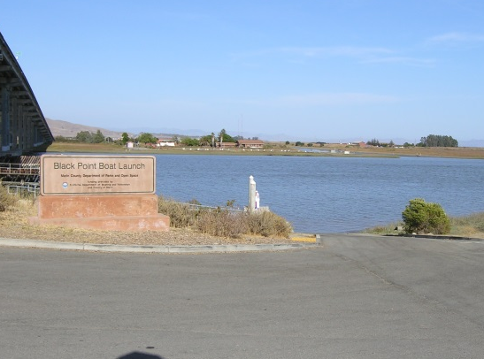
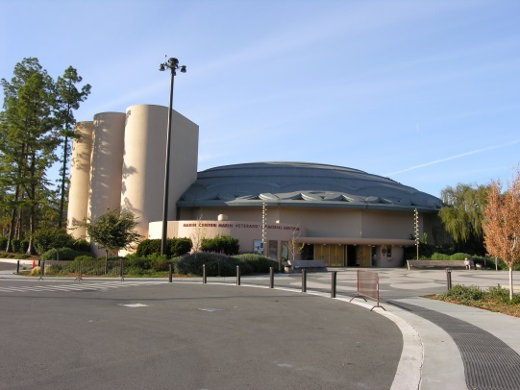
Next Steps for
Municipally Owned/Operated Facilities
Create facility assessment protocols and inspection form (Sept. 2015)
Conduct assessments – Fall/Winter 2015-16
Designate outfalls receiving discharges from Hot Spots as Priority Monitoring Outfalls
Notes:
MCSTOPPP staff will be contacting member agencies in the Spring to obtain a list of facilities
ALL FACILITIES! Corps yards, fire and police stations, pools, parks, libraries, municipal buildings… too many facility types to list… even parking lots!
Once the lists and maps are complete, then inspect each facility to determine “hotspot” facilities (corp. yards, airports, etc.).

Slide 28
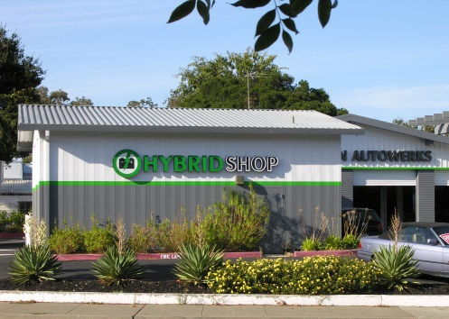
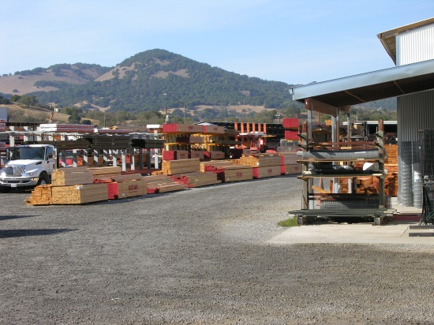
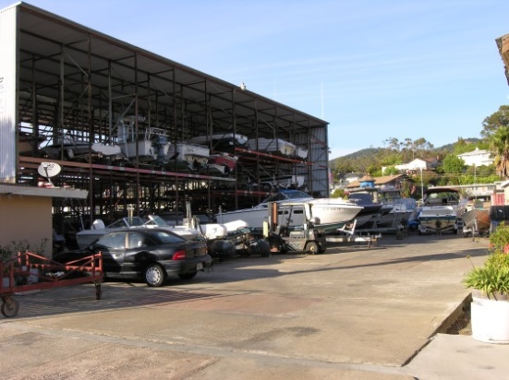
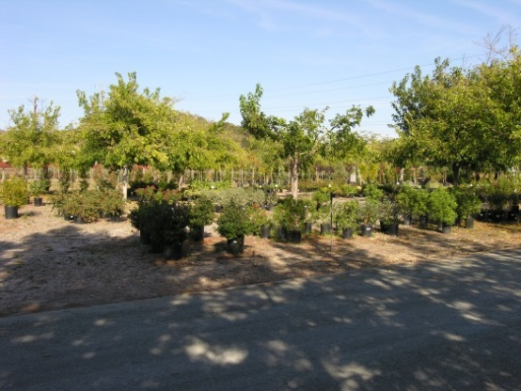
Business as Usual!
Well not quite…
Annually update business list
Continue working with partnering inspection agencies on all businesses they inspect
Inspect facilities not currently covered on their list
Conduct targeted outreach to businesses as needed
Notes:
Some municipalities may not have any of these business types
We will continue to report on inspections completed by other agencies for other types of businesses such as restaurants, but separate from this requirement.

Slide 29

Thank you!
A special thanks to our awesome interns!
- Jake Kramarz
- Kendall Pegan
- Michelle Gantos
Howard Bunce – Engineering Technician III, QSP
hbunce@marincounty.org
Liz Lotz – Resource Specialist GIS
elotz@marincounty.org
Terri Fashing – Stormwater Program Administrator
tfashing@marincounty.org
Christina David – Engineering Technician I
cdavid@marincounty.org
Lynne Scarpa – Outreach Program Coordinator
lscarpa@marincounty.org

