Slide 1

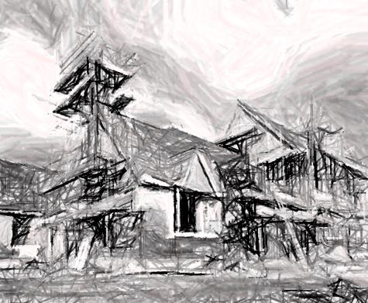
Erosion and Sediment Control Plans (ESCPs)
Marin County Stormwater Pollution Prevention Program
San Rafael, California
November 12, 2015
Notes:
Earlier we reviewed BMPs the techniques to prevent and minimize the discharge of pollutants from construction activities. In this module we are going to switch gears from the practices to how to pull the practices together into a plan of action to prevent stormwater pollution.
We will start off with some of the provisions of the Phase II stormwater permit that require these plans and then move into the plan content and how to structure the plans based on the tools developed by MCSTOPPP.

Slide 2
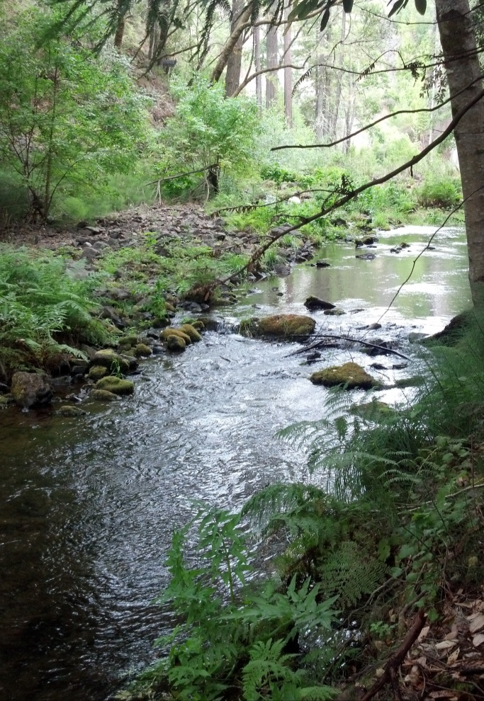
Layers of controls protect Marin Creeks
Urban runoff ordinance
CGP projects
Protects water quality
Site specific plan to protect water quality
State NPDES permit
Non-stormwater discharge provisions
Outreach to all projects
BMPs to minimize erosion and pollutant discharges
ESCP projects
Notes:
Marin’s municipalities require individuals undertaking activities that disturb soil to implement appropriate controls to prevent erosion and the discharge of sediment and other pollutants from the project site during construction.
Since 2003 Marin has implemented the Phase II Permit including construction site performance standards
Local ordinances require landowners and construction site operators to control construction site runoff and protection of water quality
In 2013 a new Phase II Permit was issued and
In 2014 local ordinances were updated to require Erosion and Sediment Control Plans

Slide 3

2013 Phase II Permit erosion control requirements
Section E.10 establishes requirements for a Construction Site Stormwater Runoff Control Program
Section E.7 establishes requirements for staff training and community outreach

Slide 4
Planning for new construction requirements
2013-2015 were key planning years for the new program
  Inventory construction sites (E.10.a)
    Track small and large projects
  Procedures to review and approve ESCPs (E.10.b)
    Created ESCP review procedure, applicant package, and template
  Construction site inspection and enforcement (E.10.c; E.6)
    Adopted revised ordinances, required ESCPs, modified inspection programs, and inspect sites

Slide 5
Training for new construction requirements
Training and outreach accompanied the roll out of new requirements and continues
  Staff training on the new procedures (E.7.b.2.a)
    ESCP Review Procedures and BMPs
    Identified municipal QSDs and QSPs for review and inspections
    Continuing staff training today
  Construction site operator outreach (E.7.b.2.b)
    Developed alerts for construction community
    Developed templates, guidance, and BMP brochures
    Invite and encourage operators to attend program training

Slide 6
ESCP knowledge basics for staff and applicants
ESCP Reviewers
ESCP Inspectors
Technical review of ESCPs
BMPs
Administrative requirements
QSD or work under the direction of a QSD
Inspection procedures
BMP assessment
QSP or work under the direction of a QSP
ESCP Developers
ESCP Implementers
ESCP requirements
BMPs
Local agency processes
BMP installation
BMP maintenance
ESCP update requirements

Slide 7
Basic requirements for ESCP content
Written plan that is submitted for local agency review and approval
Identify appropriate site-specific BMPs that will be implemented year round for the project
Explain why the BMPs were selected
Identify any other permits associated with the work
  Such as 401/404, CGP
  Applicants must provide proof other permits have been obtained before disturbing soil

Slide 8
ESCPs are required for 4 types of locally authorized projects
Projects authorized by Grading Permits
Projects authorized by Building Permits when they involve grading or soil disturbance that would have required a Grading Permit
Projects authorized by any local permit (e.g., Encroachment or Demolition Permits) when they have the potential for significant erosion or significant non-stormwater discharges (e.g., sediment, waste)
Projects designated by the local authorized official or designated municipal staff

Slide 9

SWPPPs vs ESCPs
SWPPP
ESCPs
Projects ≥ 1 acre covered by the State CGP and Local ordinance
  SWPPP addresses CGP and ESCP requirements
QSD must prepare
Projects issued local grading or building permits that disturb soil
  Note projects ≥ 1 acre subject to CGP waiver will need to prepare an ESCP
Phase II Permit does not specify qualification for preparers

Slide 10


MCSTOPPP ESCP Tools
Notes:
Procedure 3-page document that guides the reviewer through the complete the review. Applicant package contains guidance for applicants including the MCSTOPPP Standard ESCP template

Slide 11
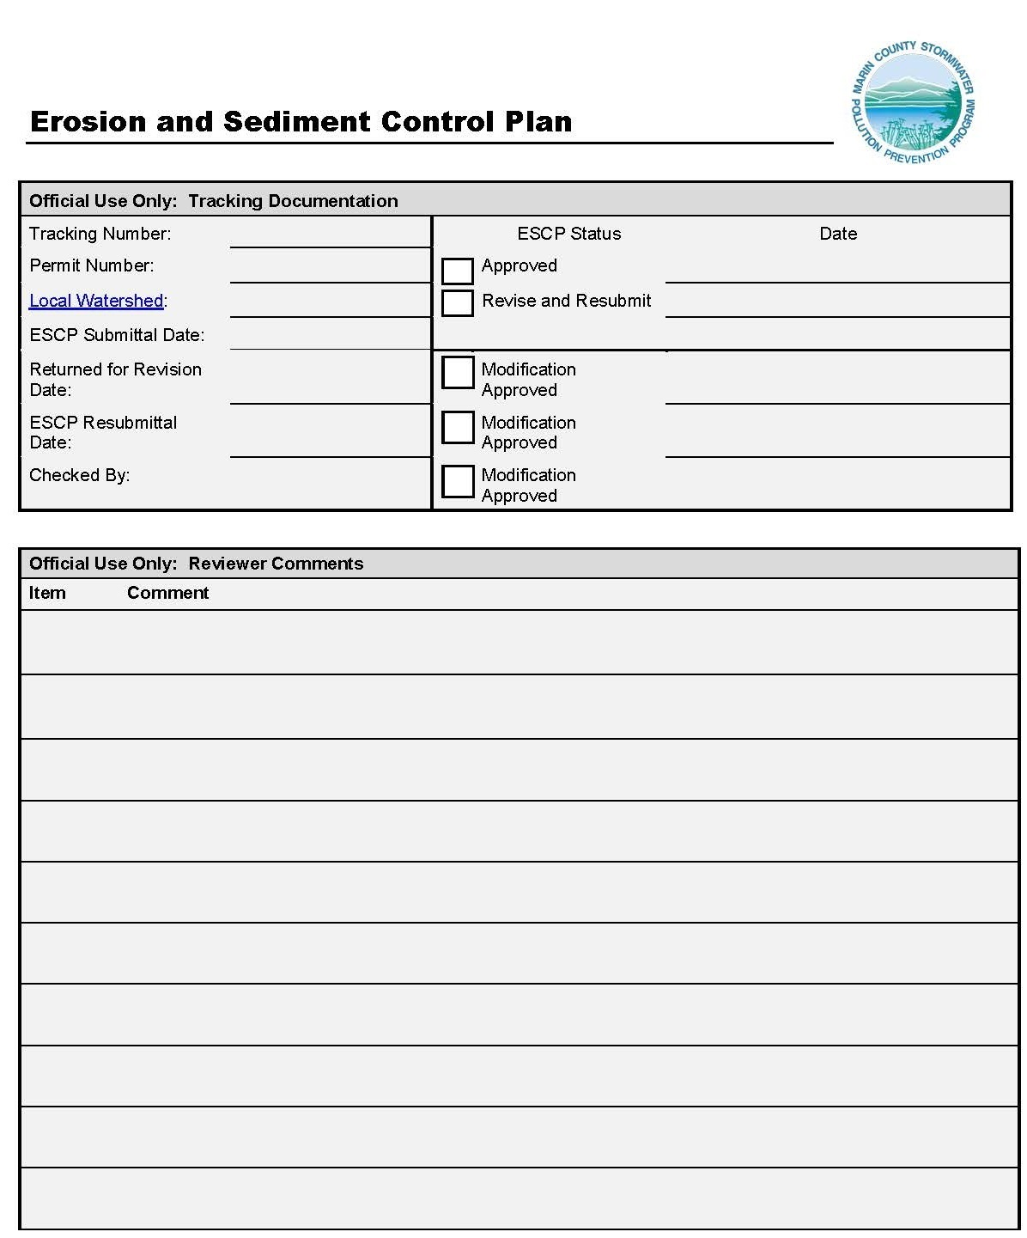
Standard ESCP Template
Core of the Tools

Slide 12
Standard template for ESCPs
Establishes standard format for content
PDF fillable-form guides applicants to provide required information in a succinct format
Review checklist & reviewer comments integrated into template
Collects inventory information
The template facilitates the preparation and review of ESCPs, streamlines the documentation process, and guides field implementation and inspection

Slide 13
Orientation to the ESCP template
Two Official Use Only sections lead the template
  Internal tracking information
  Table to document comments on ESCP
Applicants complete remaining 5 sections
  Project Information
  Applicant Information
  Other Required Permits
  Site Plan and BMP Implementation Schedule
  BMP Information

Slide 14
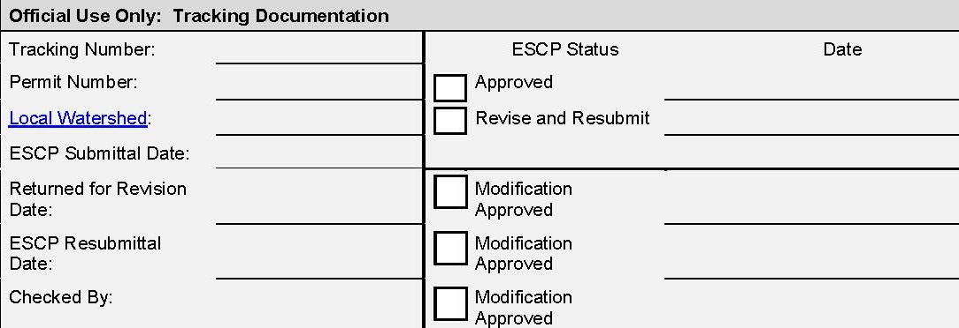
Agency Information:
Tracking Documentation
Links to Marin Watershed Map
Optional for agency to assign unique tracking number for ESCP
Use this section to track approvals of modified ESCPs

Slide 15
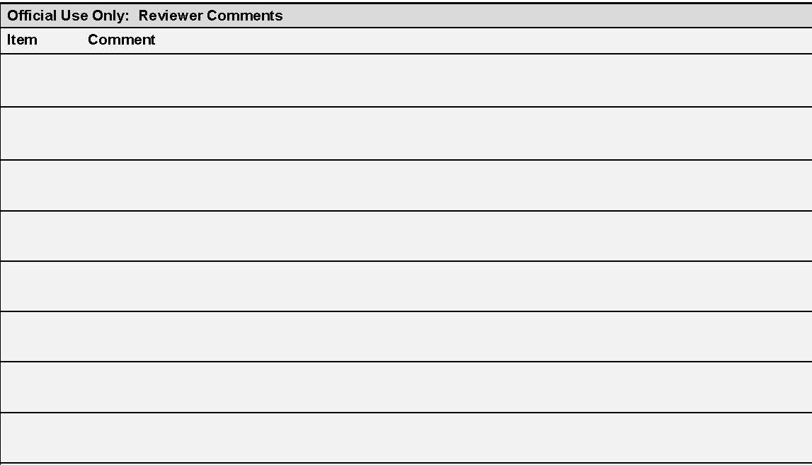
Agency Information:
Reviewers Comments
Agency: Use this section to document review comments
Applicants: Look for here for changes you need to make

Slide 16
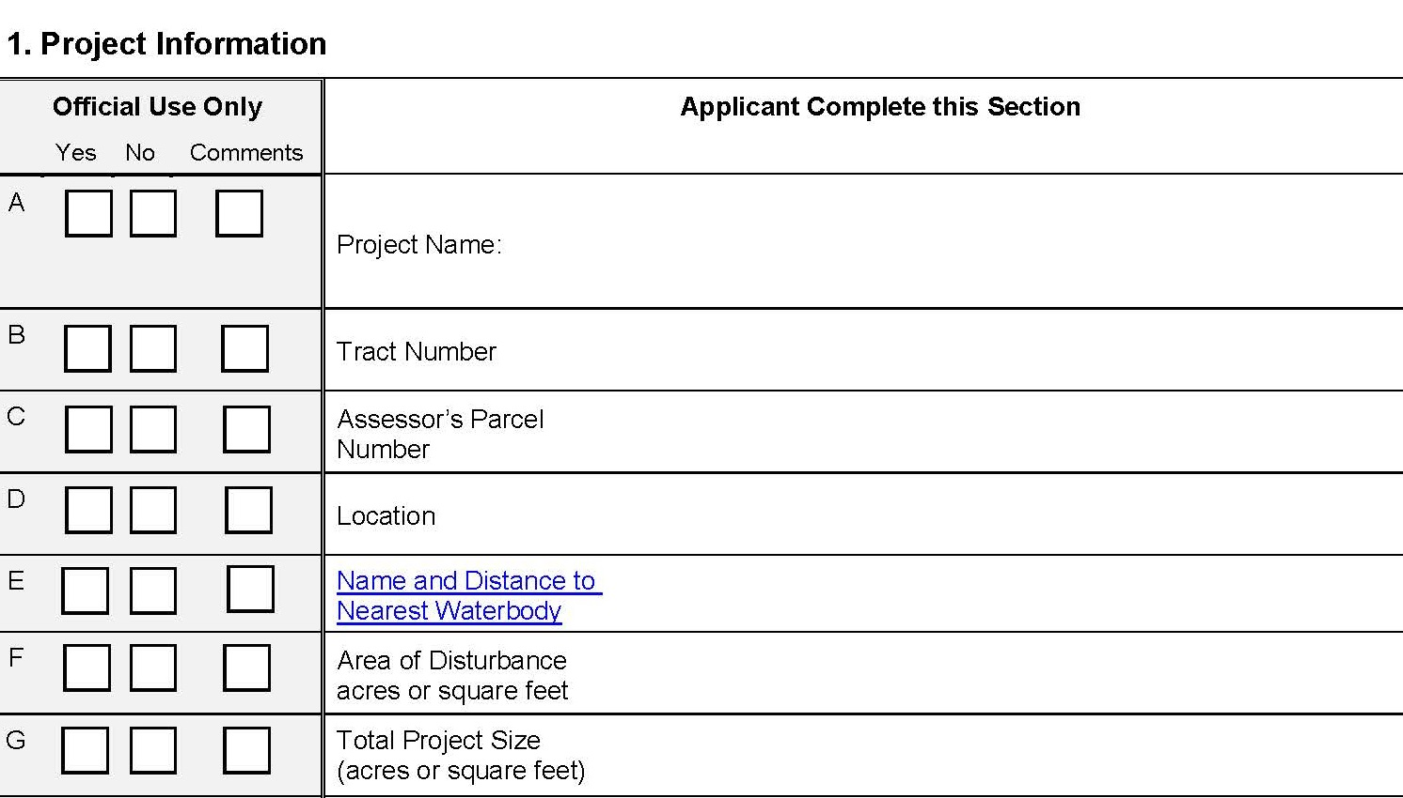
Section 1: Project Information
Where is the project?
Use the Marin Watershed Map
How much soil/ground will be disturbed?
How big is the total project?

Slide 17
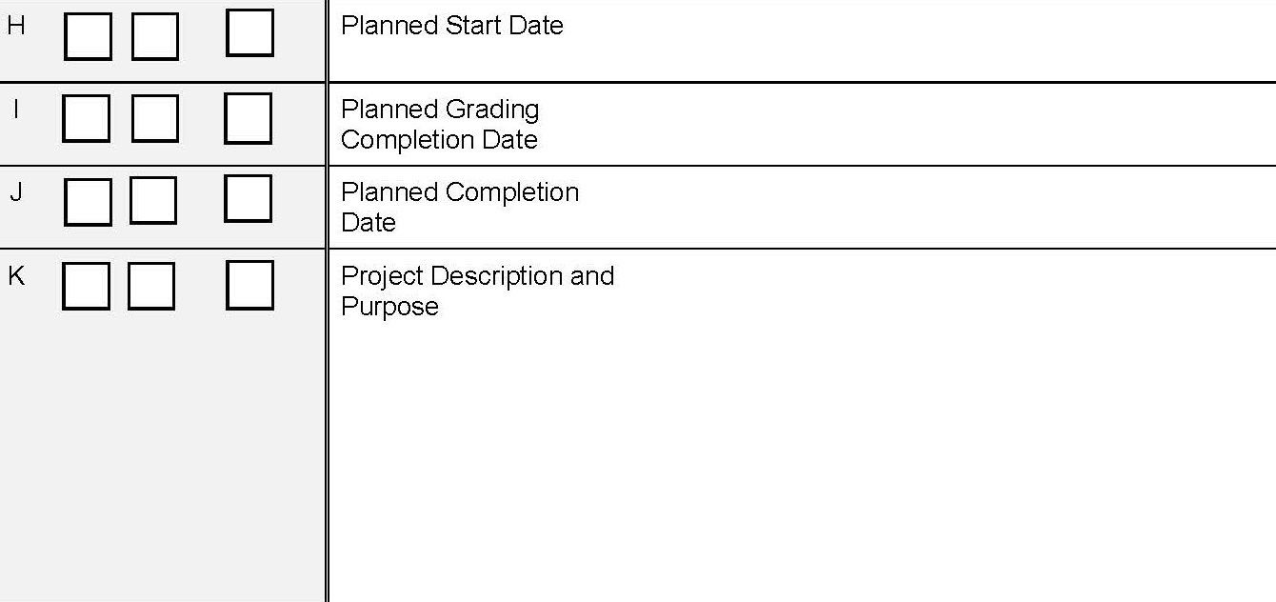
Section 1: Project Information
When will you start?
When will you be done grading?
When will everything be done/built?
What are you building?

Slide 18
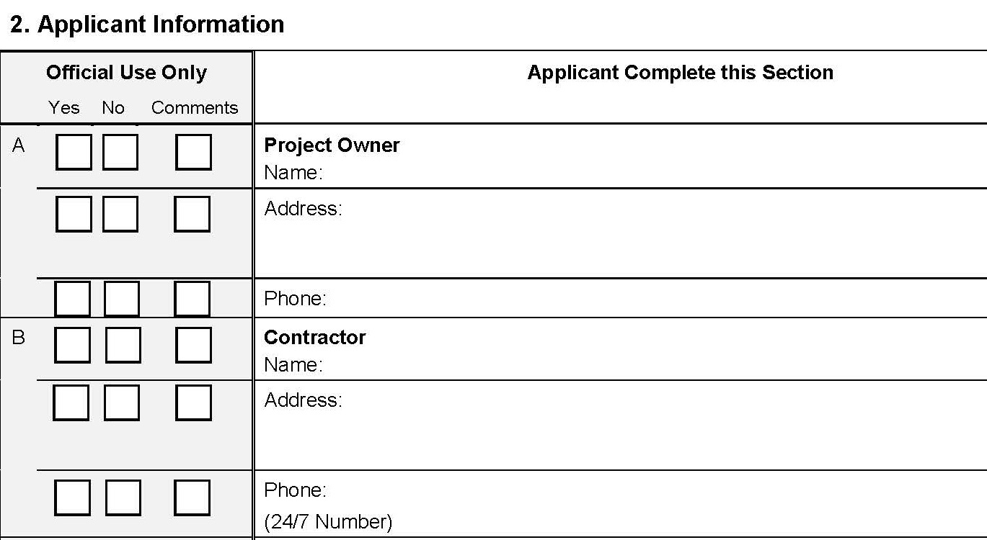
Section 2: Applicant Information
Who owns the property?
Who is building the project?
It may be the same as the owner.
Who can the inspector call on Sunday
when no one is around?

Slide 19
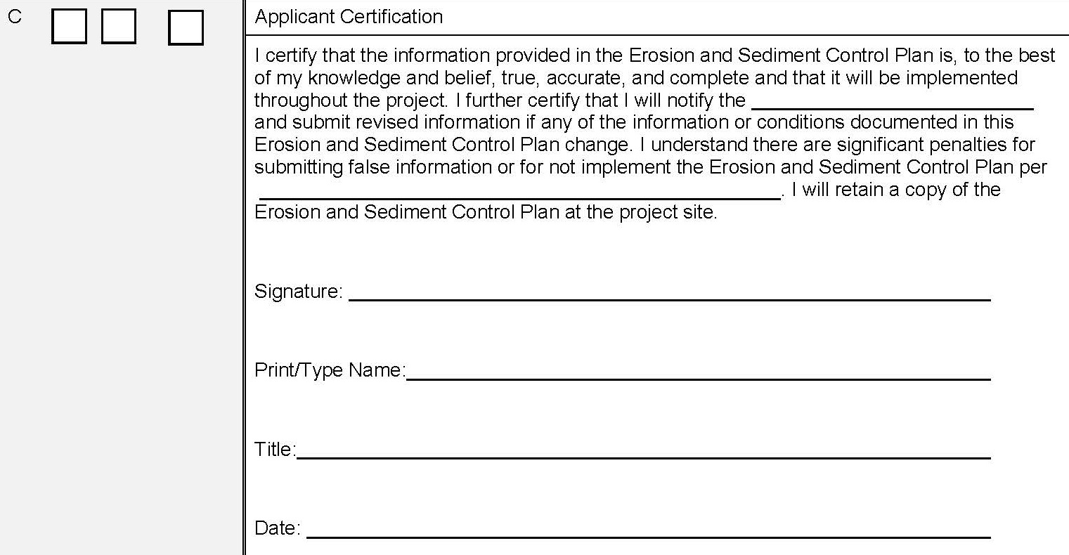
Section 2: Applicant Certification
Insert Municipal Code reference
Insert the municipality project is located in.

Slide 20
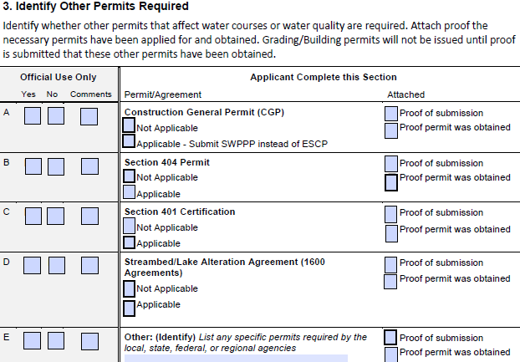
Section 3: Other Permits
Notes:
These are the main permits that are likely to be needed for most projects. Applicants and Reviewers need to understand the applicability of each permit
CGP - Issued by the State Water Resources Control Board for construction activities that disturb one acre or more of land and in some cases for smaller projects that are part of a common plan of development.
404 - Issued by the U.S. Army Corps of Engineers, San Francisco District for projects affecting waters of the U.S., including wetlands.
401- A companion permit issued by the San Francisco Bay Regional Water Quality Control Board whenever the U.S. Army Corps of Engineers issues a Section 404 Permit.
SBAA - The California Department of Fish and Wildlife issues Streambed Alteration Agreements for projects that will affect a stream or lake.
Any local permits required for the protection of creeks and water courses should be listed.

Slide 21
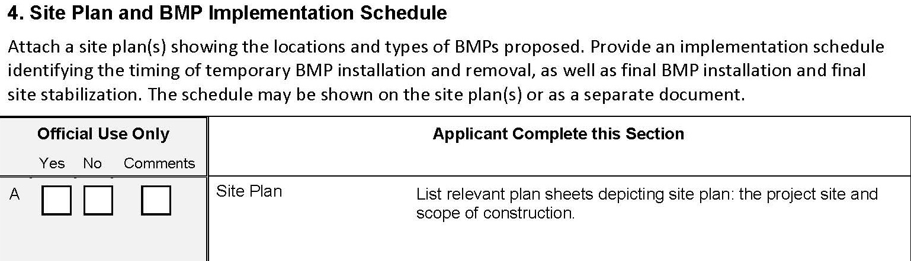
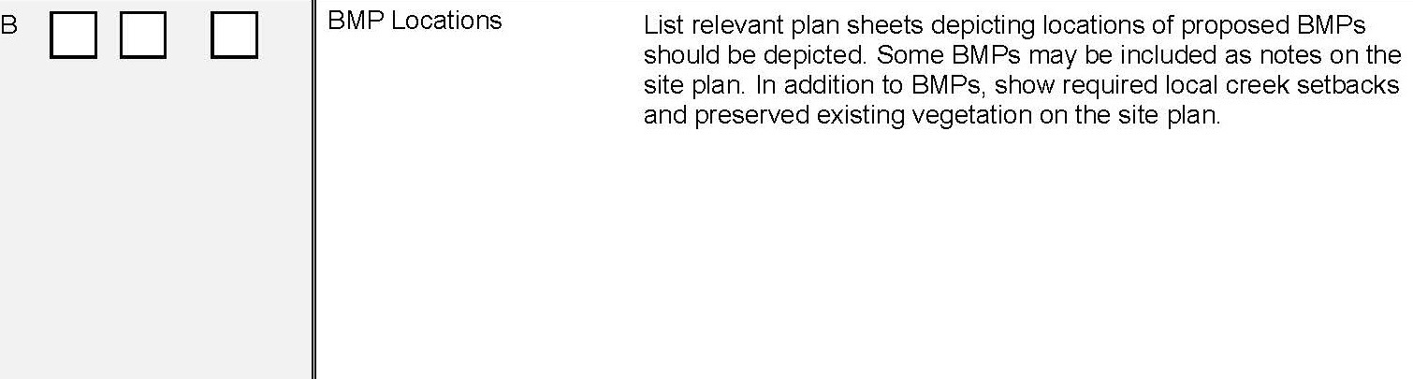
Section 4: Site Plan and BMP Locations
Notes:
In the ESCP template this section provides reference to the attached information. Sheet numbers will allow the reviewer to find the information.
Make sure the site plan matches the description provided in section 1.
Show on the site maps all the BMPs that are listed in Section 5. Show locations to demonstrate appropriate use of BMPs, e.g., silt fences are not in streams or running perpendicular to slopes. Site perimeter is protected. Waste and material management practices are planned and in protected locations.

Slide 22
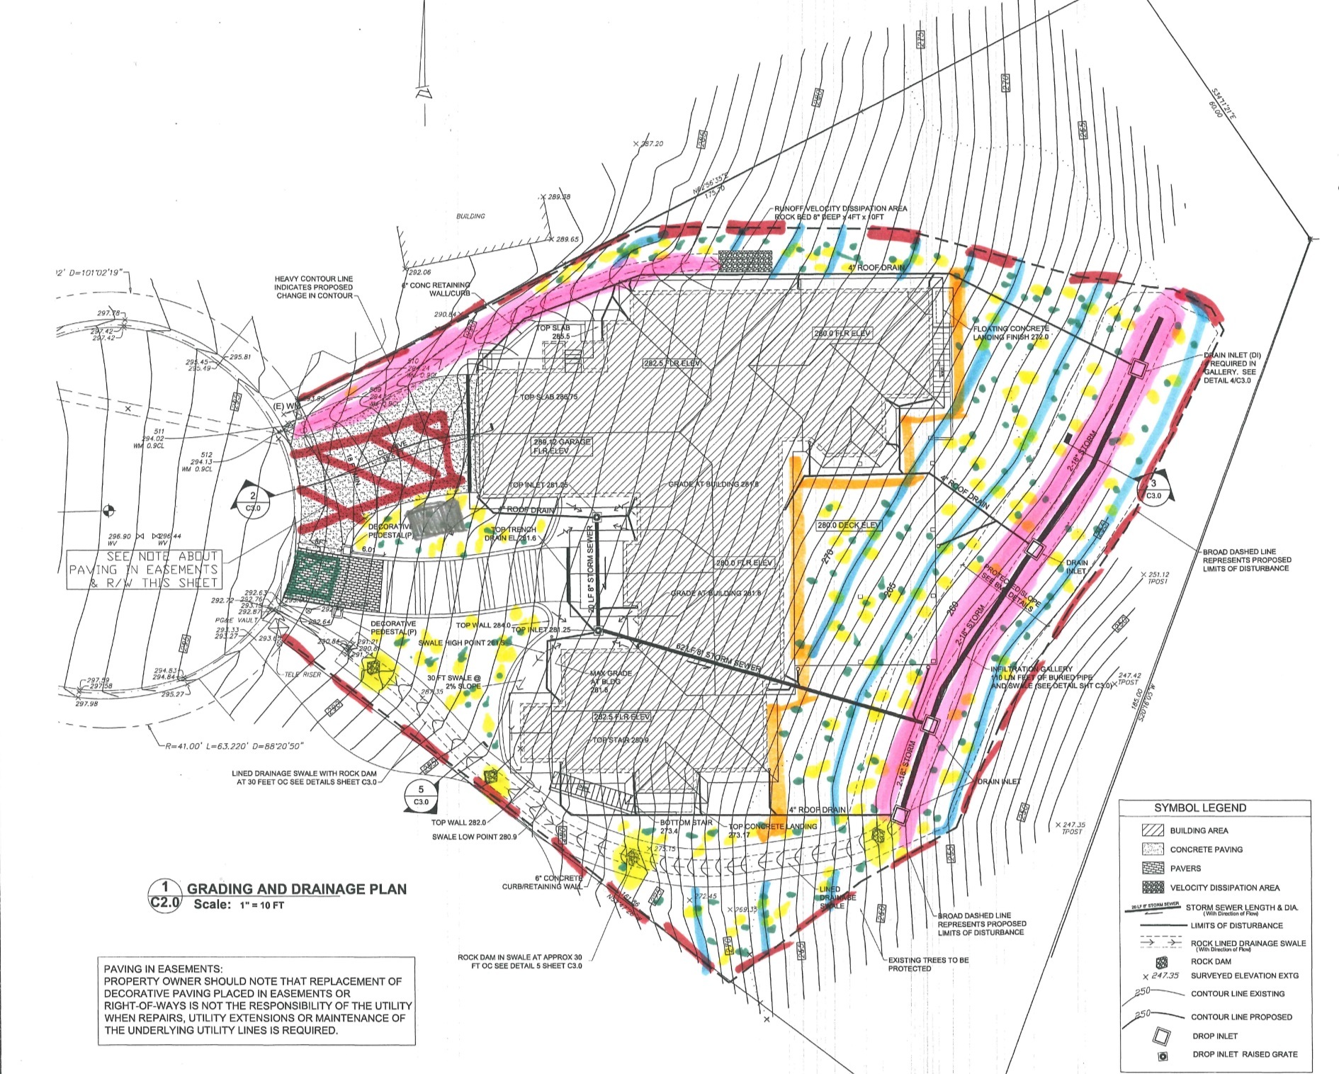

Slide 23
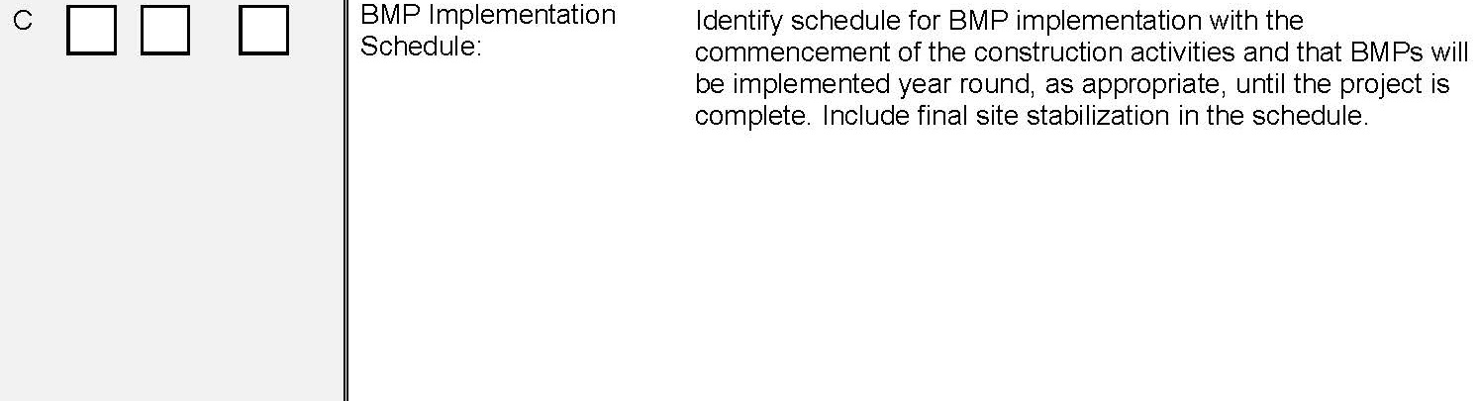
Section 4: BMP Schedule
Notes:
Provide a schedule for when BMPs will be implemented. Some BMPs will start with the construction – perimeter controls, entrance. Others may be tied to specific activities, concrete wash out is needed when concrete work will start.

Slide 24
Sequence of Major Construction Activities:
Aug 15-20 Clear and grub lot Aug 21-26 Grade and compact building pad Aug 26-28 Pour slab Aug 28-Sept 3 Cure time Aug 26-Sept 3 Install storm drainage system Sept 4-Jan 15 Framing and construction, tie in utilities, exterior finishes Jan 15-Feb 25 Painting, landscaping, complete interiors Feb 25 -Mar 1 Complete punch-list and demobilize

Slide 25
Sequence of Major Construction Activities & BMPs:
Aug 15 Install snow fence to mark limits of disturbance; install construction entrance; install portable toilets; install waste containers (trash cans) Aug 15-20 Clear and grub lot Aug 20 or immediately after grubbing Install perimeter fiber roll Aug 21-26 Grade and compact building pad Aug 26 Install silt fence at perimeter of building pad Aug 26 Install concrete washout Aug 26-28 Pour slab Aug 28-Sept 3 Cure time Aug 26-Sept 3 Install storm drainage system Sept 4 Install DI protection

Slide 26
Sequence of Major Construction Activities & BMPs:
Sept 5-Sept 15 Install slope fiber rolls, erosion control blankets, hydroseeding, and straw mulch Sept 4-Jan 15 Framing and construction, tie in utilities, exterior finishes Sept 4 Augment waste containers and pickup for vertical construction phase Jan 15-Feb 25 Painting, landscaping, complete interiors Jan 15 Install self-contained paint washout in garage Feb 1 Remove temporary sediment control measures from slopes, weed-whack grass, plant permanent vegetation, seed with native mix, top dress with mulch Feb 1- Mar 1 monitor landscaping and repair failures Feb 25 -Mar 1 Complete punch-list and demobilize

Slide 27
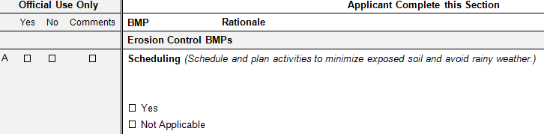
Section 5: BMP Information
Applicants identify and explain BMPs
  Three categories of BMPs
    Erosion Control
    Sediment Control
    Good Housekeeping
Notes:
There are three categories of BMPs – BMPs are needed from all categories to create an effective combination of controls to protect water quality

Slide 28
BMP | Rationale
SEDIMENT CONTROL BMPS
Tracking Control
X Yes ☐ Not Applicable |  | A stabilized construction entrance will be installed prior to grading and maintained through the grading phase. Once the concrete slab and driveways are poured, vehicles will not access the lot – all work will be from the driveway.
Fiber Rolls
X Yes ☐ Not Applicable |  | 12-inch diameter fiber rolls will be installed along the graded slopes to break up the slope length; rolls will be spaced ~ 15-feet, or less, apart along the contour. A 20-inch diameter fiber roll will be installed along the perimeter of the disturbed area to provide perimeter control. Fiber rolls will be installed per CASQA spec, along contours, overlapped, with j-hooks at the ends. This forms the second layer of sediment control from the graded area.

Slide 29
ESCP must be approved by the municipality
Complete and submit ESCP to the municipality for approval
  Revise ESCP based on comments and resubmit
  Work can start only after the ESCP has been approved and all other permits have been issued
Changes to the ESCP before or during construction must also be approved
SWPPPs submitted in lieu of ESCPs are also subject to local approval
  SWPPP changes that affect the ESCP requirements must be approved

Slide 30
ESCP standard template compiles key information
Key contacts
  Owner
  Contractor
Project dates
BMPs that will be implemented and why
BMP implementation schedule
Site Map showing BMP locations

Slide 31
Role of the ESCP reviewer
Require use of MCSTOPPP Standard ESCP Template – provide applicants with template and instructions
Use Standard ESCP Template to document review and approval of ESCP
Be familiar with standard construction site BMPs
  Understand what they are, how they work, and when to deploy them
Know who your QSD is and seek his/her advice on BMPs and ESCPs

Slide 32
Role of ESCP preparer
Use the MCSTOPPP Standard ESCP Template to develop your ESCPs
Follow the instructions in the Applicant Package
Be familiar with standard construction site BMPs
  Understand what they are, how they work, and when to deploy them

Slide 33
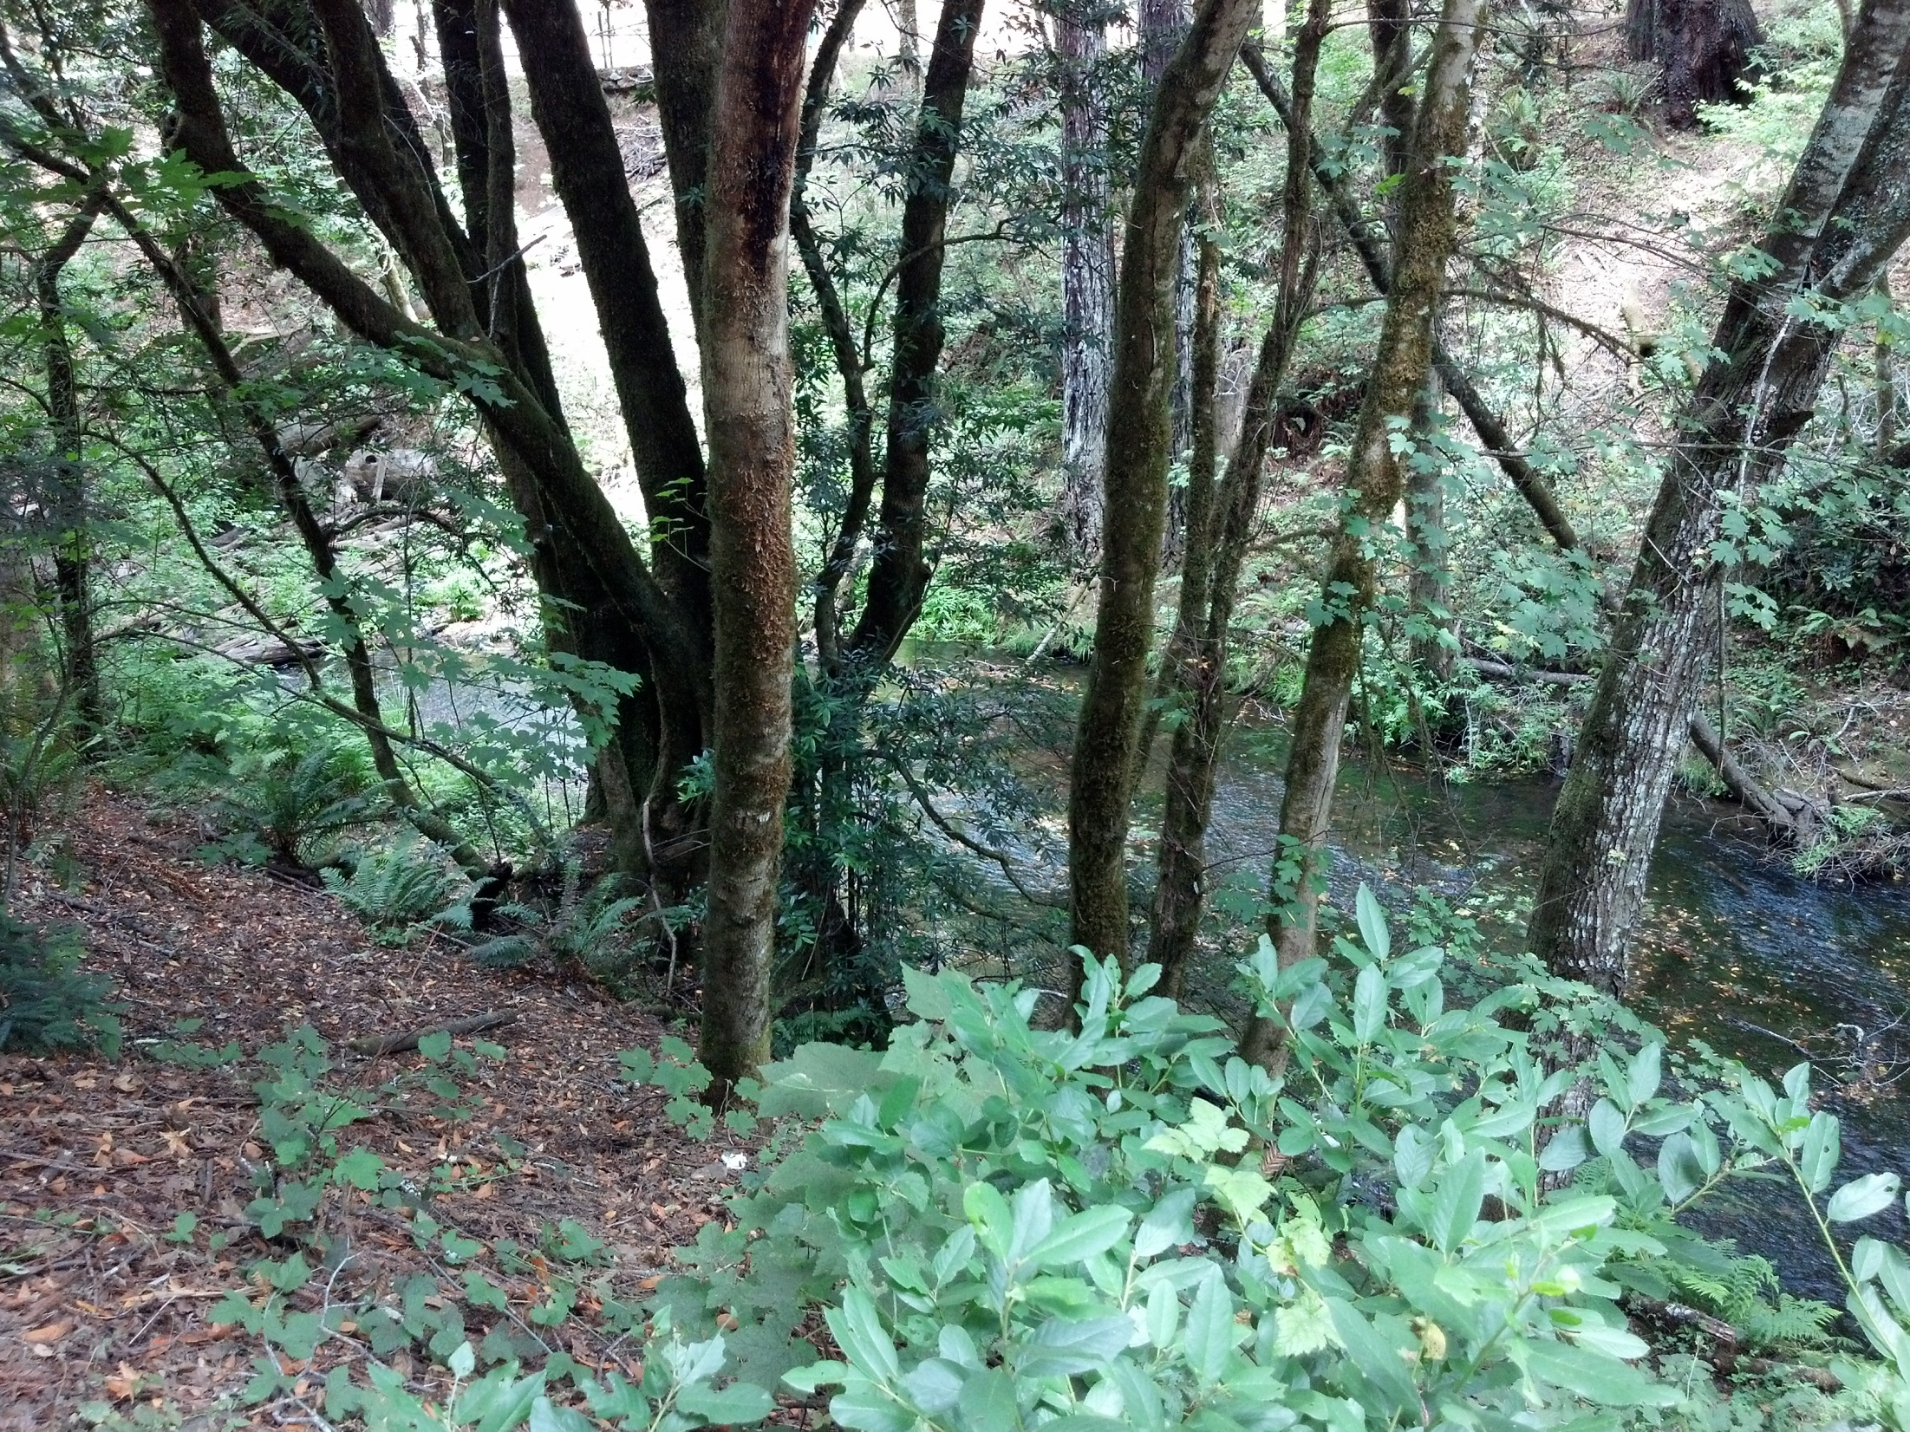
Questions

